Slide 1
AppSecure
Network Application Firewalls vs. Contemporary Threats
CanSecWest 2011
Brad Woodberg, Juniper Networks
bwoodberg@juniper.net

Slide 2
Agenda
Discussion
Beyond Layer 4 – App-FW Explained
Can Do / Can’t Do, Vulnerabilities and Limitations
Exploitation in Action
Getting it Right
Key Issues
Application Firewalling does not replace traditional security mechanisms like stateful firewall and full IPS
Application Firewalling has limitations even when properly implemented, there are also a number of potential network pitfalls.
How to properly deploy this technology in conjunction with traditional security mechanisms.

Slide 3
Evolution
Client: 1.1.1.1
Server:
2.2.2.2
Src-IP: 1.1.1.1, Dest-IP: 2.2.2.2, Src-Port 2481, Dest-Port 80, Protocol TCP, (SYN)
Access List
Src-IP: 2.2.2.2, Dest-IP: 1.1.1,1, Src-Port 80, Dest-Port 2481, Protocol TCP, (SYN/ACK)
Stateful Firewall
Src-IP: 1.1.1.1, Dest-IP: 2.2.2.2, Src-Port 2481, Dest-Port 80, Protocol TCP, (ACK)
Application Firewall
Src-IP: 1.1.1.1, Dest-IP: 2.2.2.2, Src-Port 2481, Dest-Port 80, Protocol TCP, (ACK)
Full IPS
Src-IP: 2.2.2.2, Dest-IP: 1.1.1,1, Src-Port 80, Dest-Port 2481, Protocol TCP, (ACK)
GET /index.html HTTP /1.0
Host: www.google.com
User-Agent: Mozilla/5.0
Accept: text/html
Accept-Language: en-us
Accept-Encoding
Accept-Encoding: gzip,deflate
Accept-Charset: ISO-8859-1
Keep-Alive: 115
Connections: keep-alive
Src-IP: 2.2.2.2, Dest-IP: 1.1.1,1, Src-Port 80, Dest-Port 2481, Protocol TCP, (ACK)
HTTP/1.1 200 OK
Content-Type: text/html
Server: Apache
Date: Wed, 09 Feb 2011
Cache-Control, private
<malicious javascript, aurora exploit, shellcode>
Notes:
First we had stateless access lists which could only identify some fixed information in individual packets
Next we got stateful firewall which tracked packets of the same session and added stateful controls where applicable. Also had more intelligence to help protect network stacks. Stateful firewall typically only inspects the connection through layer 4.
Then we got IPS to protect against network and application layer exploits. This typically inspects the entire connection including the payload.
Now we have application firewalling which can be used to identify applications running on a network and does so by inspecting the payload, but only a portion of it.

Slide 4
What’s new?
Application Identification (AppID) goes beyond traditional stateful firewalls by inspecting some Layer 7 payload to identify the application.
AppID does not inspect the entire session like full IPS, and only identifies the application, not other activity like exploits.
AppID has actually be around for a long time in numerous technologies, but was not typically a user controlled feature.
Notes:
AppFW goes beyond a stateful firewall to inspect part of the payload to determine the application of the flow
AppFW only inspects limited data in the connection to identify the application, IPS does full inspection
AppFW only identifies applications, and does not protect against actual exploits or other unwanted application behavior.
AppFW uses Application ID to identify the application which has been around for a long time

Slide 5
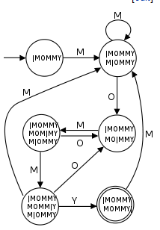
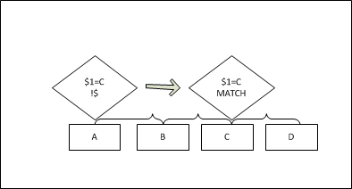
Appid Pattern Matching
FW Check
Preprocessing: Serialize, Order, Reassemble
Pattern Match
String Matching Algorithms
Boyer-Moore
Aho-Corasick (Hybrid)
Rabin-Karp
Finite State Machines
DFA, NFA, Hybrids
Hardware, other algorithms
Many other solutions exist…
*Source: http://en.wikipedia.org/wiki/String_searching_algorithm
Notes:
AppID uses pattern matching techniques similar to that of full IPS
Many of these techniques are from the academic area and are well known
Some can be optimized in hardware

Slide 6
Nested Applications
Layer 1: Cat 5, Fiber, Wifi
Layer 2: Ethernet
Layer 3: IPv4, IPv6
Layer 4: TCP, UDP
Layer 7: HTTP
Layer 7: Nested Application
Pandora Streaming Audio
Facebook Application
Notes:
Some applications like HTTP can be a transport for other applications, so we must examine these applications beyond the initial application to identify the real application.
Sometimes we want to allow an application but not certain operations like file transfers, therefore we must look deeper into the application to determine what operation is occurring.

Slide 7
Application ID Signature Examples
Layer 7 Application ID Example
Layer 7 Nested Application ID Example
application FTP:
client-to-server:
dfa-pattern "\[(USER|STAT|PORT|CHMOD|ACCOUNT|BY E|ASCII|GLOB|HELP|AUTH|SYST|QUIT|STOR |PASV|CWD|PWD|MDTM).*"; etc etc etc
server-to-client:
dfa-pattern "(220|230|331|530).*"; etc etc etc
nested-application Facebook:Application
parent-protocol HTTP;
member m01
context http-header-host;
pattern "(.*\.)?(facebook\.com|fbcdn\.net)"; etc etc etc
direction client-to-server;
member m02
context HTTP URL
pattern "/ap\.php\?i=.*|.*"; etc etc etc
direction client-to-server;
*Note many implementations use Closed Source AppID signatures
Notes:
Sample of A Layer 7 AppID signature and a Nested Application Signature
Note the directionality of the matches, and the pattern matching
Note that many implementations do not share their signatures openly

Slide 8
features that rely on Application ID
Layer 7 services may rely on the results of AppID to determine if they are interested in the session, so tricking Application ID can have impacts on whether these services are used or not.
Application Firewall
IPS
Src-IP: 1.1.1.1
Dst-IP: 2.2.2.2
Dst-Port: 80
Src-Port: 41932
Protocol: TCP
Anti-Virus
Session = HTTP
APP ID
URL Filtering
Anti-Spam
DLP
QoS
Notes:
The application information that is collected by AppID can be leveraged by other modules besides just AppFW. There are many, above are some examples.
This also means that if AppID is tricked then other modules may be tricked as well if they rely on the information gathered in AppID.

Slide 9
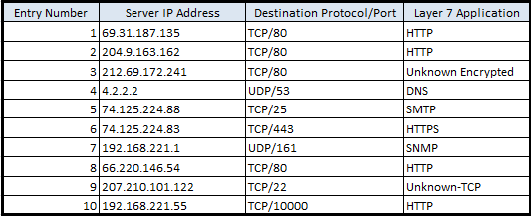
Application Caching
Application ID is Expensive
Results typically the same for IP/Protocol/Port
Improved Performance
Sample Application Cache Table
Notes:
Performing AppID is performance impacting
Results typically do not change
Cache entry to improve processing after first pass.
Typically Destination IP, L4 Protocol, L4 Destination Port + Application/Nested Application
Future connections are classified according to the cache entry
Misidentification of AppID can be used to bypass traffic for future connections
Any vulnerability that exists in AppID can be amplified when Application Caching is enabled (often the default.)
Poisoned Application Cache entries can impact other L7 services like UTM, IPS from functioning properly or being implemented at all.

Slide 10
\(Pre\)Processing
Notes:
10

Slide 11
Preprocessing: Fragmentation / Segmentation
Like IPS, Application Firewall must serialize, order, and reassemble packets/application data before trying to do pattern matching.
E.g. Matching pattern “HTTP” in a GET request “GET /index.html HTTP/1.0”
Multiple IP Fragments, must reassemble before we can do pattern matching, or we will not detect string “HTTP” in any individual packet
one packet, (no reassembly required)
IP Packet 1
IP Packet 2
IP Packet 3
IP Packet 4
GET /index.html HTTP/1.0
GET
HT
TP/1.0
GET /index.html HTTP/1.0
/index.html
Notes:
Preprocessing is important to ensure we can’t be tricked into incorrectly detecting an incorrect application, but may not be done by all application firewalls for performance reasons.
Fragmentation happens at the IP Layer, Segmentation happens at the TCP Layer, applications can also split up the messages which is typically implemented on a protocol by protocol basis and can vary in implementation.
Fragmentation/Segmentation may happen due to MTU limitations along the path, or the attacker might purposefully use these techniques to try to bypass the AppFW. There are numerous well known evasion techniques in this area.
This example shows the importance of matching based upon fragmented traffic.

Slide 12
Preprocessing: Ordering
We must properly order packets/segments before performing pattern matching
E.g. Matching pattern “HTTP” in a GET request “GET /index.html HTTP/1.0”
Multiple IP Fragments/Segments, must reassemble before we can do pattern matching, or we will not detect string “HTTP” in any individual packet
Multiple packets/segments, out of order
Reassembled, we can match the pattern properly now
IP Packet 3
IP Packet 2
IP Packet 1
IP Packet 4
HT
/index.html
GET
TP/1.0
GET /index.html HTTP/1.0
Notes:
We must also ensure that the traffic is processed in the correct order. Traffic may arrive unordered naturally, especially when traversing the global internet, but it might also be sent out of order by an attacker.
There are numerous well known evasion techniques in this area.

Slide 13
Preprocessing: Proper Reassembly
What if attacker sends two fragements/segments with a different payload?
E.g. Matching pattern “HTTP” in a GET request “GET /index.html HTTP/1.0”
(permitted segment 3)
HTTP
Segment 1
Segment 2
Segment 4
GET
/index.html
/1.0
SIP
(denied segment 3)
Notes:
Other attacks exist against the reassembly of application traffic such as duplicate fragements/segments with differing data. We must thoroughly preprocess to try to protect against these anomalous attacks.

Slide 14
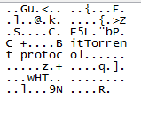
Network Application Identification
Notes:
14

Slide 15
Application Identification 1/3
Must Pass Some Traffic (Bi-directionally) before Application can be identified
In this example, TCP 3-way handshake completed, but no L7 payload has been sent so application has not be identified.
Notes:
After 3-Way TCP Handshake, no data yet, so we don’t know what the application is because no payload has been sent. In this example, the implementation uses application “0” to indicate no application yet determined. The output shows both the packet capture and the session table.

Slide 16
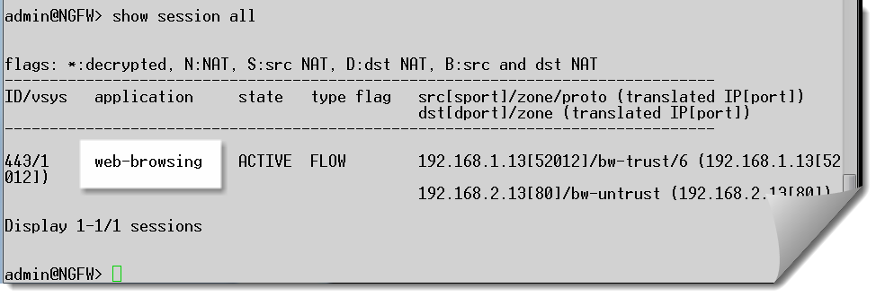
Application Identification 2/3
Actual detection must occur on payload, here HTTP has been identified after Layer 7 exchange.
Notes:
Now we send some HTTP traffic in the session and we can see that the application identification has completed and it has been properly determined to be HTTP.

Slide 17
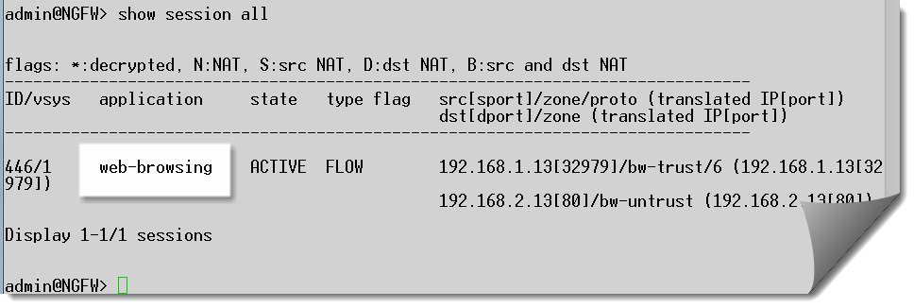
Application Identification 3/3
Application Firewalling itself doesn’t inspect beyond the application ID, so it doesn’t stop attacks.
Notes:
In this example we show that AppFW alone does not protect against malicious behavior such as exploit attempts. This exploit tries to launch a command shell on the victim web server. As long as the application is permitted then unless some higher level mechanism is in place such as IPS the attack will not be blocked by AppFW.

Slide 18
Limitations Vulnerabilities Exploitation
Notes:
18

Slide 19
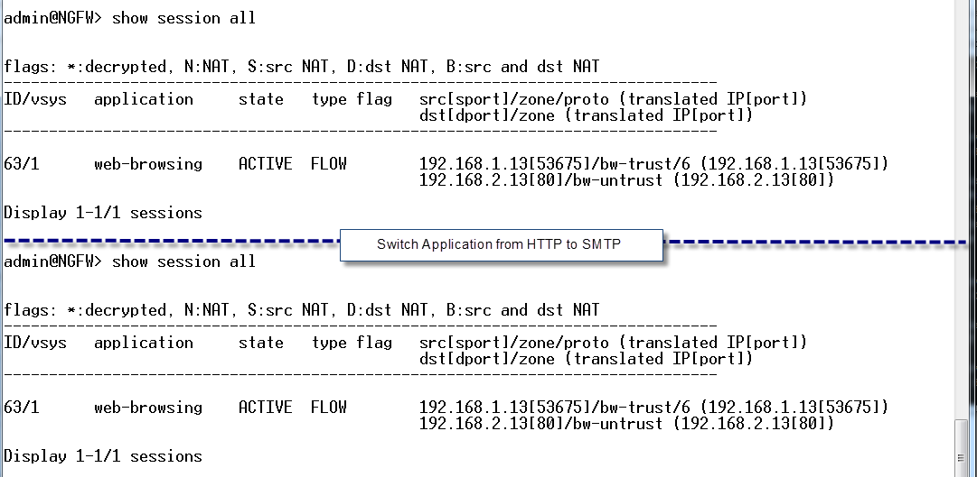
Client / Server collusion
Start connection as a permitted application, after Application Firewall is done, switch it to another!
Notes:
AppFW keeps honest applications honest, but it can be tricked, especially when both the client and server are colluding to trick it. IPS anomaly detection can be a good defense when implemented properly.
In this example we start the connection with the application as HTTP which is allowed by AppFW, then switch it to SMTP mid-session which we don’t allow. Since Application-Firewall is only looking at a few hundred – few thousand bytes, AppFW alone will not pick up this attack.

Slide 20
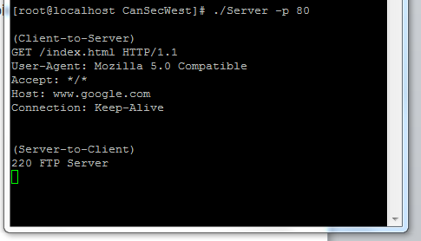
Importance of bidirectional inspection
May not inspect both Client to Server and Server to Client: Poisoned Results
Notes:
Not all implementations are built alike.
This example demonstrates what can happen if we don’t properly check both Client to Server and Server to Client directions for proper application checks, we even had IPS enabled for this one.

Slide 21
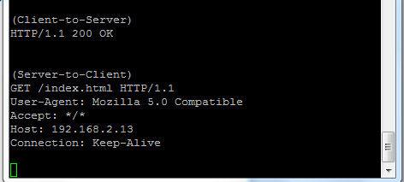
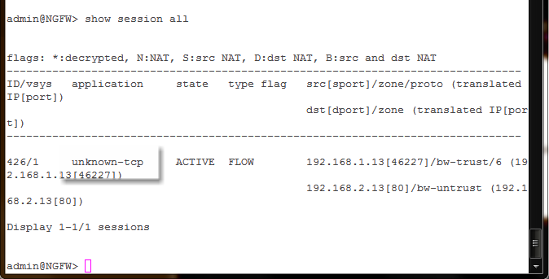
Reversing Protocol Traffic
Application Firewall may not differentiate the Client and the Server directions, this can be used to trick AppFW and other Layer 7 services.
What happens if you switch the client to server and server to client traffic, do you an improper match?
For this AppFW, no, but perhaps others?
Notes:
AppID must be looking for patterns in the right direction and not just anywhere in the session otherwise they can be tricked. This attack didn’t work here, but it might trick some vendors especially those with a weak implementation.

Slide 22
Port based detection?
Perhaps not all detection is actually based on actual application identification, some may only inspect on certain ports, or may just deem a certain port an application without an AppID match.
DNS Traffic on Port 53
Exact same traffic on any other port
Notes:
Tested DNS on different ports, and it was unknown on other ports, even though the traffic was the exact same.

Slide 23
Application Cache Poisoning 1/6
Example, simple policy, block SMTP on any port, allow anything else
Notes:
We talked about why to use Application Caching, but it also has some risks which this example demonstrates. This screen shows the configured AppFW policy which blocks SMTP on any port but allows anything else.

Slide 24
Application Cache Poisoning 2/6
We try sending SMTP over port 80, it get’s blocked as expected
(Server-to-Client)
220 smtp.example.com ESMTP Postfix
Notes:
Here we demonstrate that SMTP will be blocked, after the AppFW sees the STC string it identifies it as SMTP and blocks the connection which is shown in the AppFW logs.

Slide 25
Application Cache Poisoning 3/6
Let’s poison the cache with HTTP first (with several connections for good measure) then try the same test.
Application 109 stands for HTTP, we sent 20 separate HTTP connections to 192.168.2.13 on port 80
Notes:
Here we look at the application cache and see something about a count / threshold as 16, so we generate 20 requests for good measure that are HTTP (this system uses AppID 109 as Web-Browsing in this view.) With 20 attempts we pass the threshold and have some cache “Hits”

Slide 26
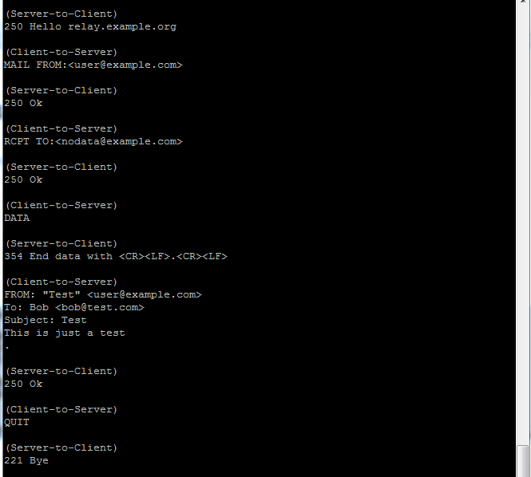
Application Cache Poisoning 4/6
Now send SMTP traffic in a new connection, same port / protocol / server, it’s permitted!

Slide 27
Application Cache Poisoning 5/6
Cache Hit!
Notes:
Now open a new connection and use only SMTP on TCP port 80 to server 192.168.2.13, which has a cache entry. The AppFW doesn’t block it because it believes it is HTTP based on the cache.

Slide 28
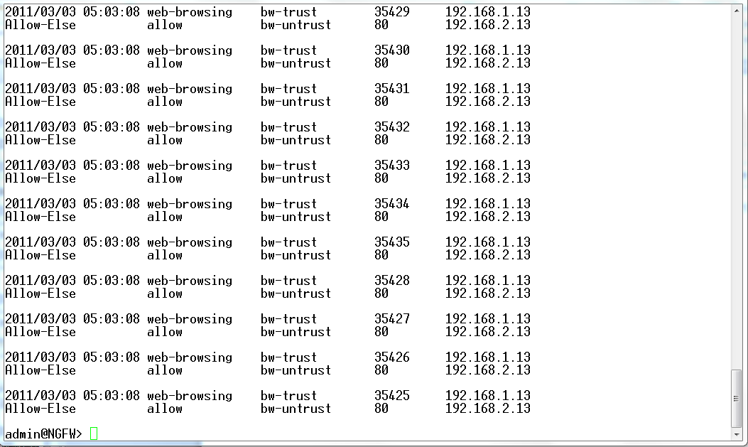
Application Cache Poisoning 6/6
All new connections are detected as HTTP, yes I was working on this at 5am.
Notes:
Logs showing the connections

Slide 29
Caching Nested Applications
This is a bad idea.
While we’d like the performance gains, multiple applications can be hosted on the same host/protocol/port both maliciously and legitimately.
Attackers can use this even more easily than port based application cache attacks.
Doesn’t require client and server collusion to work, .
Instead, we should perform AppID on all nested applications or just block the access to that server / protocol / port altogether.
Notes:
Slide explains why caching nested applications can be unreliable and in some cases dangerous

Slide 30
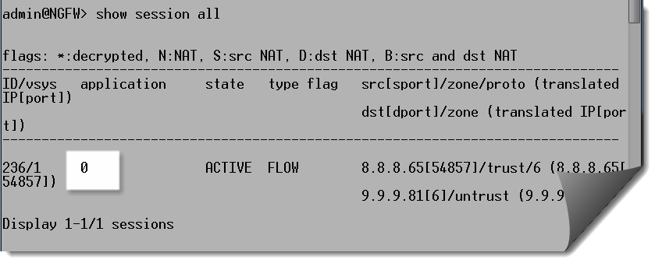
Unknown Application Protocols 1/4
What happens when Application ID can’t identify an application?
Some implementations don’t inspect traffic at layer 7 at all when the Application can’t be identified (not even stream or packet attacks!)
Step 1, open session
Notes:
What happens when this AppFW doesn’t understand an application?
First we just perform the 3-way TCP handshake, the Application hasn’t been identified.

Slide 31
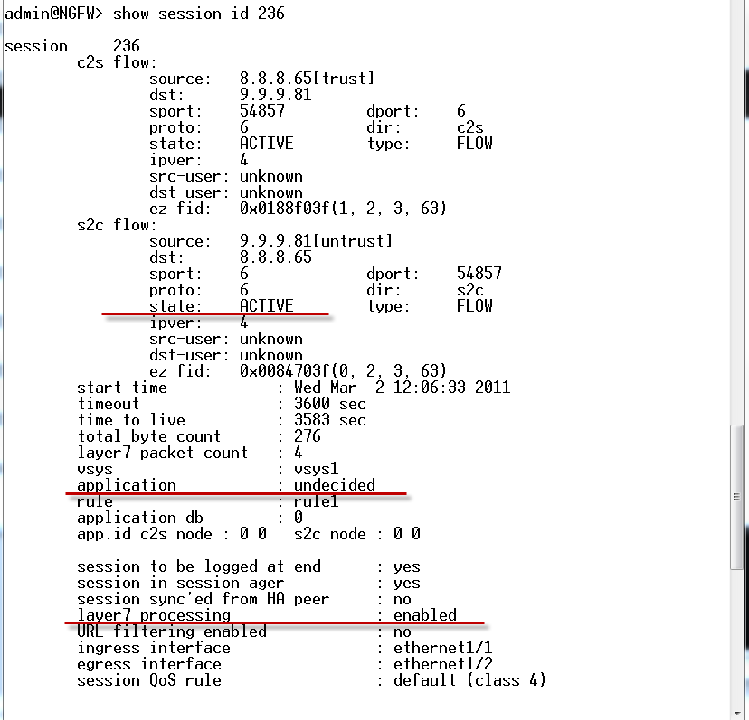
Unknown Application Protocols 2/4
Initially before the Application ID completes see that Layer 7 processing is enabled for the session
Notes:
We look at the session entry itself after the TCP 3-way handshake but before sending the L7 payload. WE see that the session state is active, the Application is “undecided” and L7 processing is enabled. Note that in this example we have Full IPS and AV enabled as L7 services for this session.

Slide 32
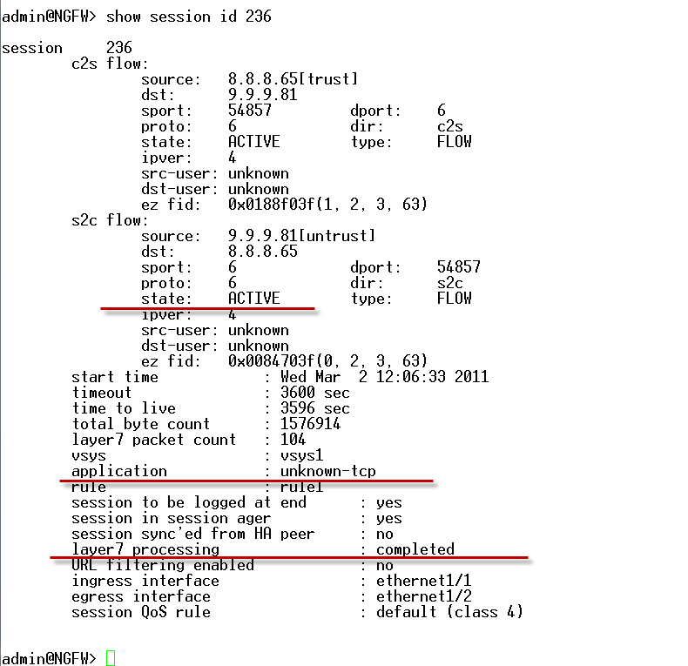
Unknown Application Protocols 3/4
We send some traffic
Once Application ID completes, no more Layer 7 processing even with Full IPS Enabled!!
Further analysis showed that the traffic was being fast pathed in the ASIC NPU at this point, the packets weren’t even being sent to the processor where FW / IPS is handled!
By Default!
Notes:
Next we send some garbage binary data which the AppFW will not be able to identify. We then look at the session info again and see that the state is still active, the application is now classified as unknown-tcp and Layer 7 processing is now completed.
We did more testing and realized that by L7 processing being completed not only was it not inspecting it with IPS/AV, it wasn’t even sending that traffic to the processor at all, it was being fast pathed in the ASIC. This behavior is on by default, and even if you disable the hardware offload the traffic will still not be inspected by the IPS engine.

Slide 33
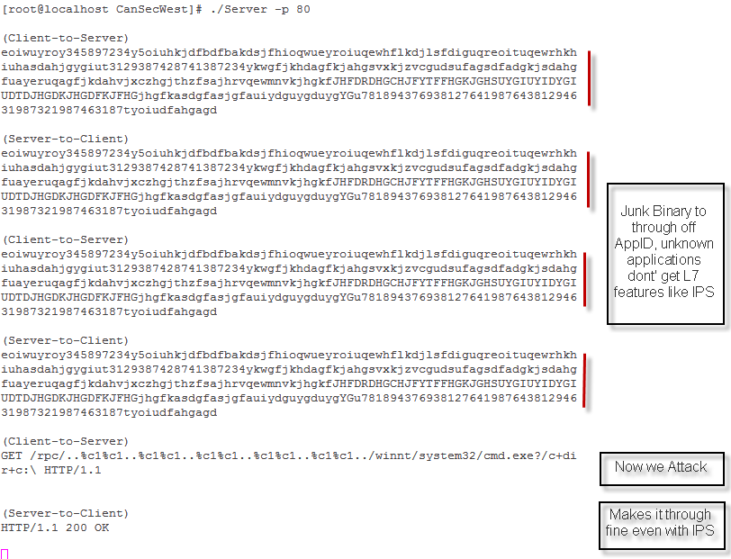
Unknown Application Protocols 4/4
Application Level Exchange
Notes:
Here we show the exchanges in action, after the binary data we could even send an exploit through which doesn’t get blocked!

Slide 34
Obfuscation
Encryption: You can’t really use a signature. A common technique is if a protocol is unknown, to measure the randomness of data (entropy) to determine if it is encrypted. Typically this can’t tell what the application is, but rather that it is an unknown encrypted application.
Steganography: Hiding a message in plain sight. This is a very hard problem to solve, an Application Firewall or IPS likely won’t be able to detect this. Bayesian-like filtering would need to be used to improve detection.
Tunneling: Applications can be tunneled in other protocols (e.g. GRE, IPinIP, SSL, and many other derivatives. Application Firewall may not be able to detect inner protocols.
Encrypted BitTorrent Application, no standard pattern.
<BitTorrent Client>
Data: 474554202F616E6E6F756E63653F696E666F5F686173683D...
<BitTorrent Server>
Data: 485454502F312E3020323030204F4B0D0A436F6E74656E74...
Notes:
Slide mostly speaks for itself, not all applications can be detected with a pattern, and some require additional preprocessing. Application developers are getting more crafty at writing hard to detect applications (typically for those that are blocked by ISP/Organization/Government filters.) Some other mechanisms exist to try to detect these applications but it’s definitely cat and mouse.

Slide 35
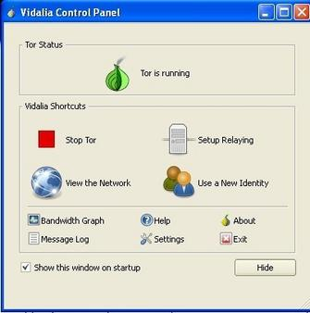
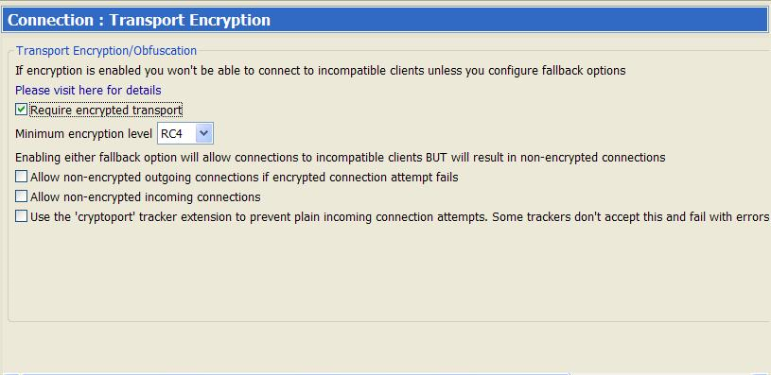
AppID w/o Pattern matching
Some application identification isn’t based upon application signatures at all. This is especially true of encrypted applications where pattern match is not reliable.
Some detection may be based upon IP Address, for instance classifying known P2P Supernodes or TOR exit points based upon IP address and not based on an actual pattern match or other heuristic method.
Some detection is a combination of IP based matching and pattern matching for other aspects of the traffic.
Notes:
Discussion of encrypted application and how they can be detected.
Note that some of these are detected by IP or other port based info rather than by heuristic or pattern mechanisms.

Slide 36
What does Application Firewall change?
It is a step better than Stateful Firewall alone, but a subset of real IPS.
It’s a lightweight way to keep honest applications honest, compared to IPS (thus likely a lower cost).
If already using a solid firewall + IPS implementation, it can save IPS time by not inspecting unwanted “honest” applications.
Can be used to block unknown encrypted communication, but some obfuscation methods like steganography are likely to evade.

Slide 37
Solving Limitations in AppFW
Application / Protocol Anomaly Detection
Full IPS for Exploit Protection
Disable Caching
Check default settings
In addition, everything you already know still holds true
Network Access Control
Strict control over access to the network.
Quarantine guest/compromised hosts.
Stateful Firewall:
1. Deploy with full stateful FW
Leverage L3/L4 IPS Protections and Session Control
Always use a tight FW rulebase with strict control on source/destination IP Addresses + L4 Protocol/Ports
Full IPS:
Full IPS solution should be used with appropriately tuned policy on top of Stateful FW + Application FW.
Leverage Protocol Anomaly Protection to detect evasion techniques
Don’t just use IDS mode!
Malware Protection
Network Based Malware protection and URL Filtering can be helpful, but additional protection is needed.
Desktop Malware protection is still required to protect against advanced threats
Notes:
When properly implemented this can dramatically help to block anomalous behaviors and attack vectors discussed in this presentation. Not all engines are created equal, some features may not be on by default!

Slide 38
Questions and Answers? - bwoodberg@juniper.net -
Q&A

