Slide 1
Showing How Security Has (And Hasn't) Improved, After Ten Years Of Trying
Dan Kaminsky, Chief Scientist, DKH Inc.
Michael Eddington, Partner, Déjà vu Security
Adam Cecchitti, Partner, Déjà vu Security

Slide 2
History (As I See It)
1990’s: Security == Cryptography and Java
2000’s: Bad guys show up, start owning everything
Got particularly bad in 2003
We learn how software actually fails
2010’s: The decade of defense
OK. We’ve gotten software to fail.
How do we make software not fail?
Have we gotten any better?

Slide 3
The Push For Metrics
Major efforts going on in the corporate/defensive world to try to get some sense of Return On Investment / “What Actually Works” in defense
Everybody’s. Getting. Owned.
Something’s not working.
Difference between attack and defense
Attack doesn’t work, it’s easy to tell.
Defense doesn’t work, it’s…not so easy.
What sort of metrics would be helpful?

Slide 4
Can We Get Metrics For Software Quality?
“How hard is it for an attacker to corrupt a computer exposing this particular codebase?”
Security is about systems, not about individual codebases or even just computers, but bear with me

Slide 5
A Fundamental Question
We know more things are getting compromised
Is this because attackers are getting better?
Or is this because code is getting worse?
Hypothesis: Software quality has improved over the last ten years.
Corrolary: Code is not getting worse; attackers are getting better

Slide 6
What Sort Of Experiments Could We Try?
Standard dataset usually pored through for quality metrics: CVE
CVE: Common Vulnerabilities and Exposures
Information on 48,425 vulnerabilities found (and presumably fixed) over the last ten years or so
This is lots of data!
Or is it?

Slide 7
The Problem with CVE
Fundamental bias
Conflation: Software quality with finder interest
Interest not only in finding the bugs, but reporting the bugs
Major human element (at minimum, difficult/impossible to measure as the exclusive metric)
Not that much finder interest that still reports back to vendors
We have a latency problem

Slide 8
Perhaps Static Analysis?
Could we take the source code from a large number of projects, and look at the number of “bad things” in the source code?
Sort of.
First issue: Good luck getting source code to targets
Could be bypassed if companies published their static analysis rates
This would actually be pretty cool, hint hint
Second issue: In practice, difficult to distinguish stylistic concerns from actual vulnerabilities
Much bigger problem

Slide 9
What About Fuzzing?
Fuzzing: The use of a large number of generally corrupt and machine generated test cases to attempt to find failure modes in software.
Is it possible to use the results of large scale fuzzing as a rough metric for software quality?
“Fuzzmarking”
Possibly. There’s even some precedent
BreakingPoint’s Resiliency Score against networks and network devices

Slide 10
Lets Start With The Highest Risk Stuff
Target Formats
Office Documents: .doc, .xls., .ppt
Portable Documents: .pdf
These are the formats with the highest complexity and the greatest exposure
Also, empirically they’ve been the ones that are getting us owned the most
There are two sorts of studies that can be run against these formats

Slide 11
Cross Sectional Studies: Which Parsers Are (Maybe) Safest?
Office Documents
Microsoft Word/Excel/Powerpoint
OpenOffice Writer/Calc/Impress
Portable Documents
Adobe Acrobat
Foxit Reader
GhostScript
…but there’s something way more interesting we can do.

Slide 12
Longitudinal Studies: When
We’ve been doing security for ten years.
How much has software improved in those ten years?
Has it improved?
If so, when?
We’ve taken software circa 2000, 2003, 2007, and 2010, and run synchronized fuzz tests across all of them
This is (potentially) a window into bugs that have never seen the light of a CVE
So what does the data look like?

Slide 13
188,000 Crashes In 44 Days
OK, not really.
175,334 crashes in ~44 days.
Details?
Lets talk first about process, procedure, and how you’re going to screw this up if you try to do this.

Slide 14
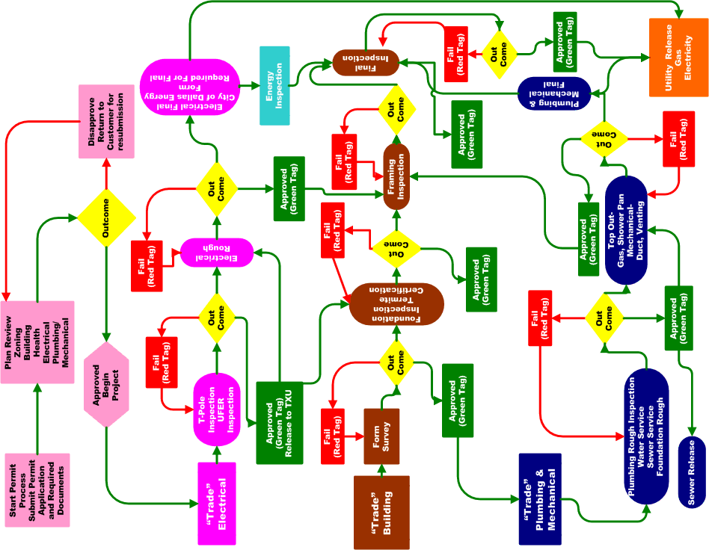
PROCESS

Slide 15
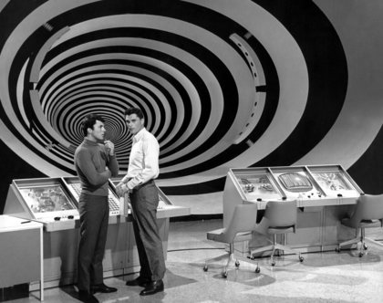
Obtain Sample Files
1
Scavenge sample files from Google
Internet Archive
Looking for files near the year 2000
This did not work out so well…

Slide 16
Generate Fuzzed Files
2
Pre-generate all fuzzed files using Peach
100,000 files per format (doc, xls, ppt, pdf)
Office: Understand OLE Storage
Fuzz the streams in doc/xls/ppt
PDF: Decompress streams
(Eventually)

Slide 17
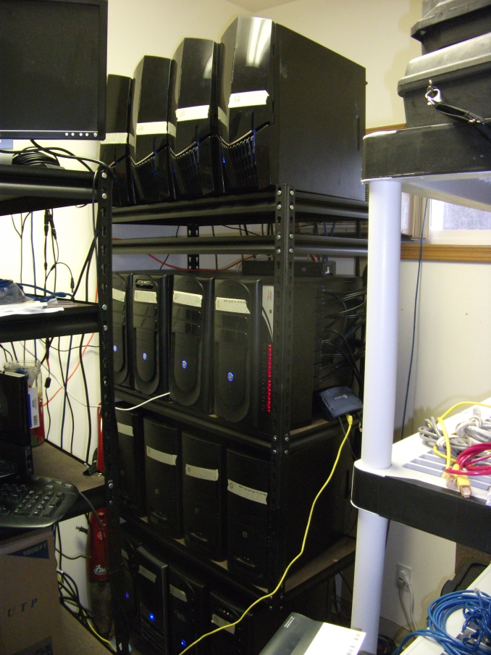
Peach Farm
3
Hosted fuzzing service from Déjà vu Security
You provide the target, we produce the crashes
For this talk…
88 Cores of fuzzing fun
5 Targets
4 File formats
>250 GB of logs

Slide 18
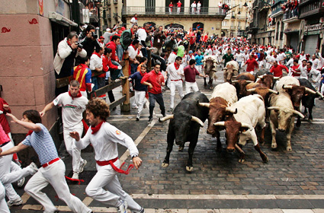
Running of the Fuzzers
4
Office 2010/2007
Thousands of Registry Keys (File recovery)
Office/OpenOffice
Tens of thousands/Gigs of temp files
OpenOffice
“Quick Start” keeps OO in memory
PDF
Compressed/Non-Compressed

Slide 19
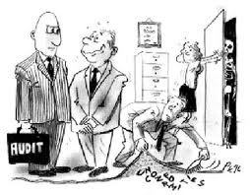
Verify Logs
5
Look correct?
Was every iteration a crash? #fail
No crashes?
Complete set?
Runs crash
Machines die
Logs misplaced

Slide 20
Mine Logs
6
Collect interesting data
Mine data into SQL
Easy to query for data sets

Slide 21
How Not To Fuzz Fuzzing
“How hard could opening a program and reading a file be?”
Run the same 100k files across 18 programs.
Every file, every program, every time.
Must open the program
Must open, read, and parse the file.
Must record the result.

Slide 22
Opening the Program
Personality
Some software has very low self esteem and needs constant attention.
“Look what I parsed!”
Each program ends up with it own personality based on how many deterrents there are to fuzzing.
Ranging from whiner to aggressive to needy.
Occasionally 30k / 50k runs we’d have to “sweet talk” the exe back into running.
Some things were predictable and others randomish.

Slide 23
Personality traits
From the program
Auto Updaters : Version 6.2 –> 6.5
Auto Upgraders : Version 6 -> 7
Bundle ware / Nag ware
Recovery of crashed files
“Safe modes”
Importing
Error reporting / Crash Analysis software
From the OS
Auto Update
Anti Virus
Scheduled scans / reboots.
Startup / OnRun / Preloaders

Slide 24
Click here to punch clippy
From the Program
Pop Ups
Registration
Surveys
Ads
Assistants

Slide 25
Files from the internet why not DLLs?
Dynamic downloads
Add Ons
Fonts / international support
Foxit from 2007 doesn’t have default JPEG support
Download and install at runtimes
Puts the program out of sync with the rest
“Static” downloads
Old documents linked to things all over the web.
Parts of the fuzzed doc / pdf are just gone.
Makes for less interesting fuzzing

Slide 26
Parsing the file
A few “docs” we crawled were really
HTML, JPEG, TIFF, PDF, JavaScript
Ended up with a lot of integrity checking of file
Crawler and verifier is around 3k lines of C# code
Normally we wouldn’t care a crash is a crash to us, but we wanted to make sure our file set was valid.

Slide 27
Things to check for
Magic Number check
Caused false positive
Searched for JavaScript and HTML tags
Basic length checks
Failed downloads / truncated uploads
Hash of file
Resume a downloaded crawl that failed.
Filename -> guid
Many files on the internet share names. “Homework1.doc”, “Expenses.xls”

Slide 28
Recording the results
Data integrity becomes very important
Collection of crashes and mining of the data requires more meta data the more complex you want to be.
Tag the results directories with
Program name, year, date, suite, file type, version, machine, iterations, and a guid.
When in doubt add another guid. No for real.
This will barely be enough to manually reconstruct the run in the event things go wrong.

Slide 29
Data Analysis (Naïve And Totally Misleading Edition)
175,334 Crashes Across 26 Codebases
Word/Excel/Powerpoint 2003/2007/2010
Acrobat/GhostView 2003/2007/2010
Foxit 2007/2010
One crash about every six seconds
One crash about every ten iterations
So What?

Slide 30
You don’t fix crashes. You fix bugs.
You don’t fix the same bug over and over
You also don’t fix bugs in the order they appear
Severity matters
How do you operationalize bug classification?

Slide 31
Told you !exploitable was important
!exploitable: Microsoft debugger extension that:
A) “Bucketizes” the crash – allowing it to be matched with similar crashes
B) Attempts to measure the severity of the crash
Yes, this can be done manually, but:
Manual analysis doesn’t scale

Slide 32
Unique Crashes
2536 Unique Major/Minor Hashes
1149 in Office
1125 in OpenOffice
181 in Ghostview
70 in Foxit
10 in Acrobat

Slide 33
Slicing Things Down
But that’s Major/Minor
Most “minor hashes” represent the same underlying bug under a single major
Depends on the product…75-95% chance of minors representing the same bug
Lets be conservative -- only consider Major
942 Unique Major Hashes
440 in Office
396 in Open Office
68 in Ghostview
32 in Foxit
5 in Acrobat

Slide 34
What About Severity?
942 Unique Major Hashes
150 EXPLOITABLE (15%)
188 PROBABLY_EXPLOITABLE (19%)
16 PROBABLY_NOT_EXPLOITABLE (1.6%)
588 UNKNOWN (62%)

Slide 35
Now, lets merge Severity with our other metrics…
This is a cross-sectional study
Is severity equally distributed across the various parsers?
This is a longitudinal study
Is severity equally distributed across the various versions?

Slide 36
Office vs. StarOffice 2003/7/10 (Exploitable/Probably Exploitable)

Slide 37
Ghostview vs. Foxit vs. Reader 2003/7/10 (E/PE)

Slide 38
Systematic Fuzzing Seems To Reflect Improving Code Quality
Fuzzmarking is implying an across the board effect – code shipped in 2003 was objectively less secure than code shipped in 2010
At least, in parsers for the highly targeted file formats doc/xls/ppt/pdf
We would be surprised if this effect showed up in parsers for file formats that do not cross security boundaries (i.e. aren’t targeted)
(But aren’t using XML/JSON)

Slide 39
Can One Compare File Formats With Fuzzmarking?
The fundamental tension
We know that some file formats “invite trouble”
Lengths
Explicit (especially 32 bit)
Overlapping
Implicit
Jump tables
Diffs (“fast saving”)
.txt is going to end up being a safer format than .doc or .pdf
But what about .doc vs. .pdf vs. .rtf?

Slide 40
Danger!
Absolute comparisons across file formats suffer conflation between raw danger of the format and quality of the fuzz tests
Are we getting more crashes because the format has more things to find?
Or are we just better at finding what’s there?

Slide 41
At least we know where we stand in this case
In our case, it’s very obvious why we have more Office crashes than PDF crashes
We’re relatively document aware in doc/xls/ppt
We’re just flipping bits on PDF
Our PDF fuzzer isn’t even decompressing yet
We were surprised to see any crashes!
(And we didn’t see any E/PE in Acrobat)
What about Office Format vs. Office Format?

Slide 42
At First Glance, Does Seem Like .doc has more bugs than others
Total Crashes Per Type
Total Unique Majors Per Type

Slide 43
When you filter to E/PE, the formats get equal…

Slide 44
Only Simultaneously Viewing Severity/Version/Type Helps
Office Doc/XLS/PPT E/PE
OpenOffice Doc/XLS/PPT E/PE

Slide 45
Analysis
What’s going on?
No serious correlation between Office and OpenOffice on .doc risk
What’s not going on?
.doc, .xls, and .ppt can’t actually have any security differential
You can reach any parser from any
We’re not going to notice that without really smart template generation

Slide 46
What About The UNKNOWN cases?
588 UNKNOWN crashes…
289 TaintedDataControlsBranchSelection (49%)
95 ReadAV (16%)
74 TaintedDataPassedToFunction (13%)
58 TaintedDataReturnedFromFunction (10%)
28 PossibleStackCorruption (5%)
27 0xe06d7363 (5%)
16 StackOverflow (3%)
1 Invalid Handle (0.1%)

Slide 47
Office vs. StarOffice 2003/7/10 (UNKNOWN)

Slide 48
From The Unknown Data…
1) There’s still improvement, but not as sharp
It’s almost like Exploitable / Probably Exploitable bugs are more likely to be fixed than Unknown bugs
2) There’s a far higher floor, even in 2010

Slide 49
Ghostview vs. Foxit vs. Reader 2003/7/10 (UNKNOWN)

Slide 50
What About PDF?
We’re still seeing improvement
PDF had an interesting artifact in E/PE – 2003 was better than 2007
This artifact is repeated in U – why?
More features in 2007 parsers
More corruption resistance in 2007 parsers
Template preference for 2007/2010 parsers

Slide 51
Another Possible Metric: Bug Rarity Profiles
Nate Lawson showed: Never just average everything together. Always look at the distributions.
Chunking down from 174K crashes to 940 unique vulns throws away a lot of data
It matters: Does a given bug take 10 rounds to find? Or 100,000?

Slide 52
Number of Crashes Per Unique Bug (A “Spectral Fingerprint” For Fuzzmarking)
Office 2003
OpenOffice Writer 2003

Slide 53
What About Bugs That Hit More Than One Target?
How do you correlate the same bug across Word and Writer?
The stack traces are different
Obviously the Major/Minor hashes are different
But the fuzz file is the same
Naïve Numbers
110,637 unique files created crashes
65989 (59%) crashed only one target
44648 (41%) crashed more than one target

Slide 54
Can We Do Better With Viz?
Can we visualize this?
Put the filename in the center
Treat the left side as “Office Word”
Treat the right side as “OpenOffice Writer”
Treat distance from the center as distance from now
Color by severity
Sort by recentness of vuln * severity
Make each pattern unique

Slide 55
Office Word 2003/2007/2010 v. OpenOffice 2003/2007/2010 [0]

Slide 56
Exploitable in Writer 2003, Unknown in Word 2003/2007/2010

Slide 57
Easy Dereferencing Back To Major Hashes
Unknown in Word 2007, PE in Writer 2010
Major Hashes

Slide 58
Other Neat Profiles (About 2000 Total)
“Gap Years” – Unknown in SW2003, PE in SW2010
“Welcome To The Club”

Slide 59
Potential Issues
Targeting an area already being swept by defenders
Code may look better than it actually is, because defenders are securing stuff exposed by these very same methods
This is ultimately the issue with all benchmarks
The only question is whether these bugs are representative of bugs that need to get fixed
Since these are the easiest flaws for an attacker to find, maybe this is OK

Slide 60
What about the fuzzer itself?
Bitflipping only works well against file formats that are tightly packed
Most new formats are all textual
Also require complex grammars
This is a first attempt, we intentionally didn’t want to pack too much intelligence in
Code coverage
Automatic grammar extraction
Automatic segmentation of file formats
Manual generation of files
Integration with memory tracing

Slide 61
Operational Conclusions
Bugs aren’t rare
Bugs aren’t hard to find
Cross Sectional Findings
Major document platforms may have bugs, but so do their competitors
Longitudinal Findings
Everybody’s code is getting better
Nobody’s code is perfect
Run the latest version of everything!

Slide 62
Conclusion
Has software quality improved over the last ten years?
Conclusion: For the set of formats tested, we find an unambiguous reduction in the number of failures, particularly when those failures show signs of being security-impacting.
What next?
Better fuzzing
Releasing of data!

Slide 63
Oh Yeah, Data!
We are immediately releasing for analysis the summary data from the fuzz run
There’s lots of interesting meat to chew on / visualize
Go to www.fuzzmark.com for more
We are not dropping 0day on anyone
Will provide the vendors with all the test cases they want
If you want the test cases, or even the stack traces, they’ll have to give us permission ☺

Slide 64
Thanks for all the fish!
Adam Cecchetti
adam@dejavusecurity.com
Mike Eddington
mike@dejavusecurity.com
http://dejavusecurity.com
http://peachfuzzer.com
Dan Kaminsky
dan@doxpara.com
http://dankaminsky.com
http://tinyurl.com/cansecfuzz
Déjà vu Security
DKH Inc.

