Slide 1
Console (In)Security: The Oncoming Storm
Chris Boyd, Senior Threat Researcher

Slide 2
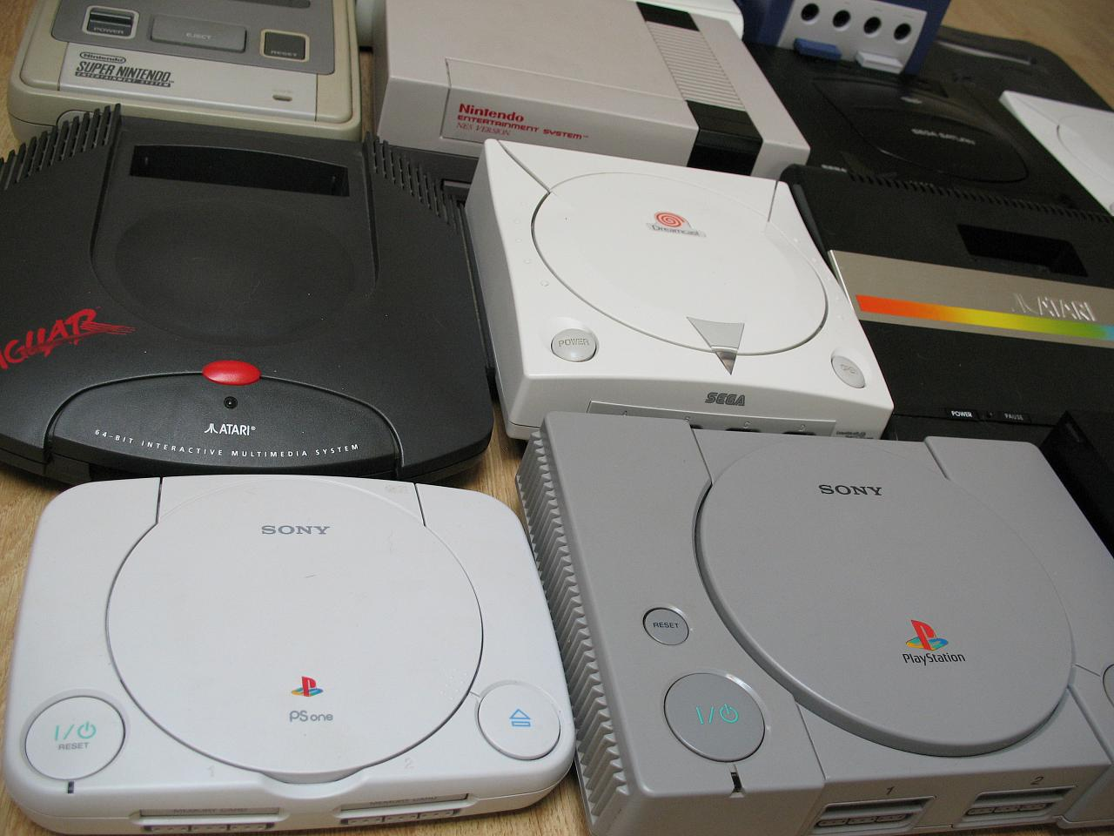
Way back when…

Slide 3
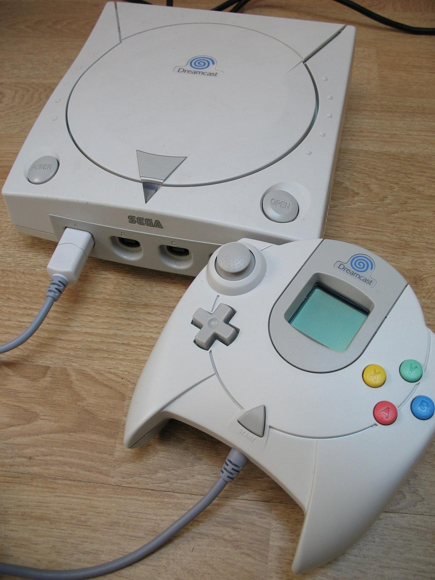
Way back when…

Slide 4
The Digital Divide
Current gen built for digital media and online gaming
Consoles released that require no physical media
The cost of digital downloads continues to rise
DRM limits value of purchase
Monetary investment in gaming accounts makes them a hot target

Slide 5
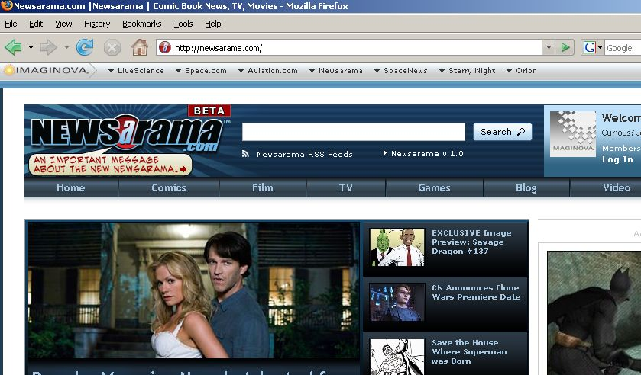

September 2008: Gaming Batman

Slide 6
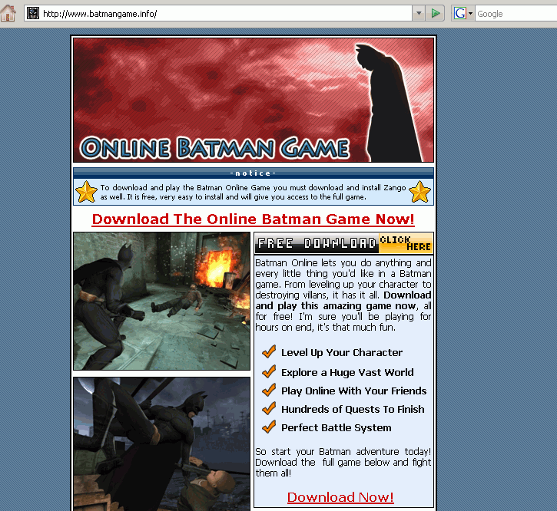
September 2008: Gaming Batman

Slide 7
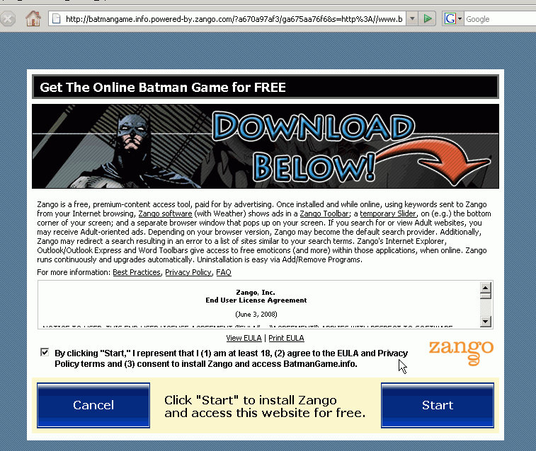
September 2008: Gaming Batman

Slide 8
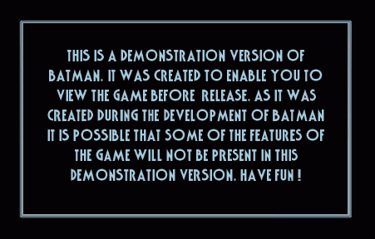
September 2008: Gaming Batman

Slide 9
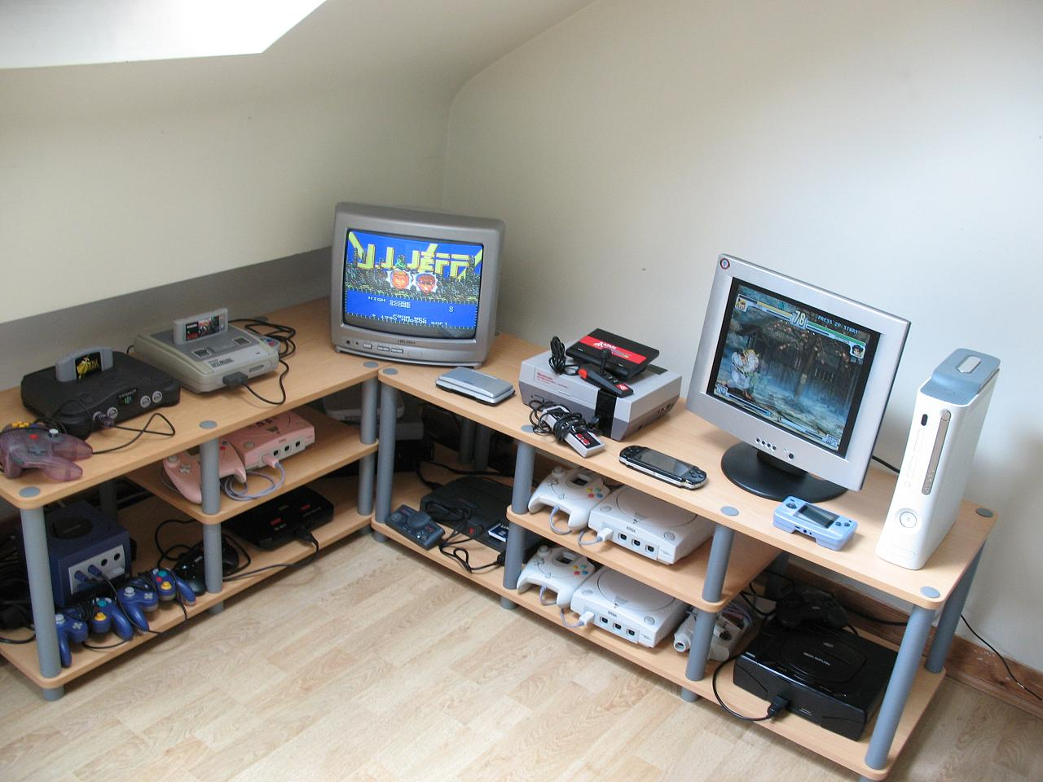
Welcome to the Lab

Slide 10
Methods of Attack
Gamers in gaming sessions (can include system tampering)
Social engineering / rogue programs online
Attacking the console maker (databases, live support)

Slide 11
Under the Hood

Slide 12
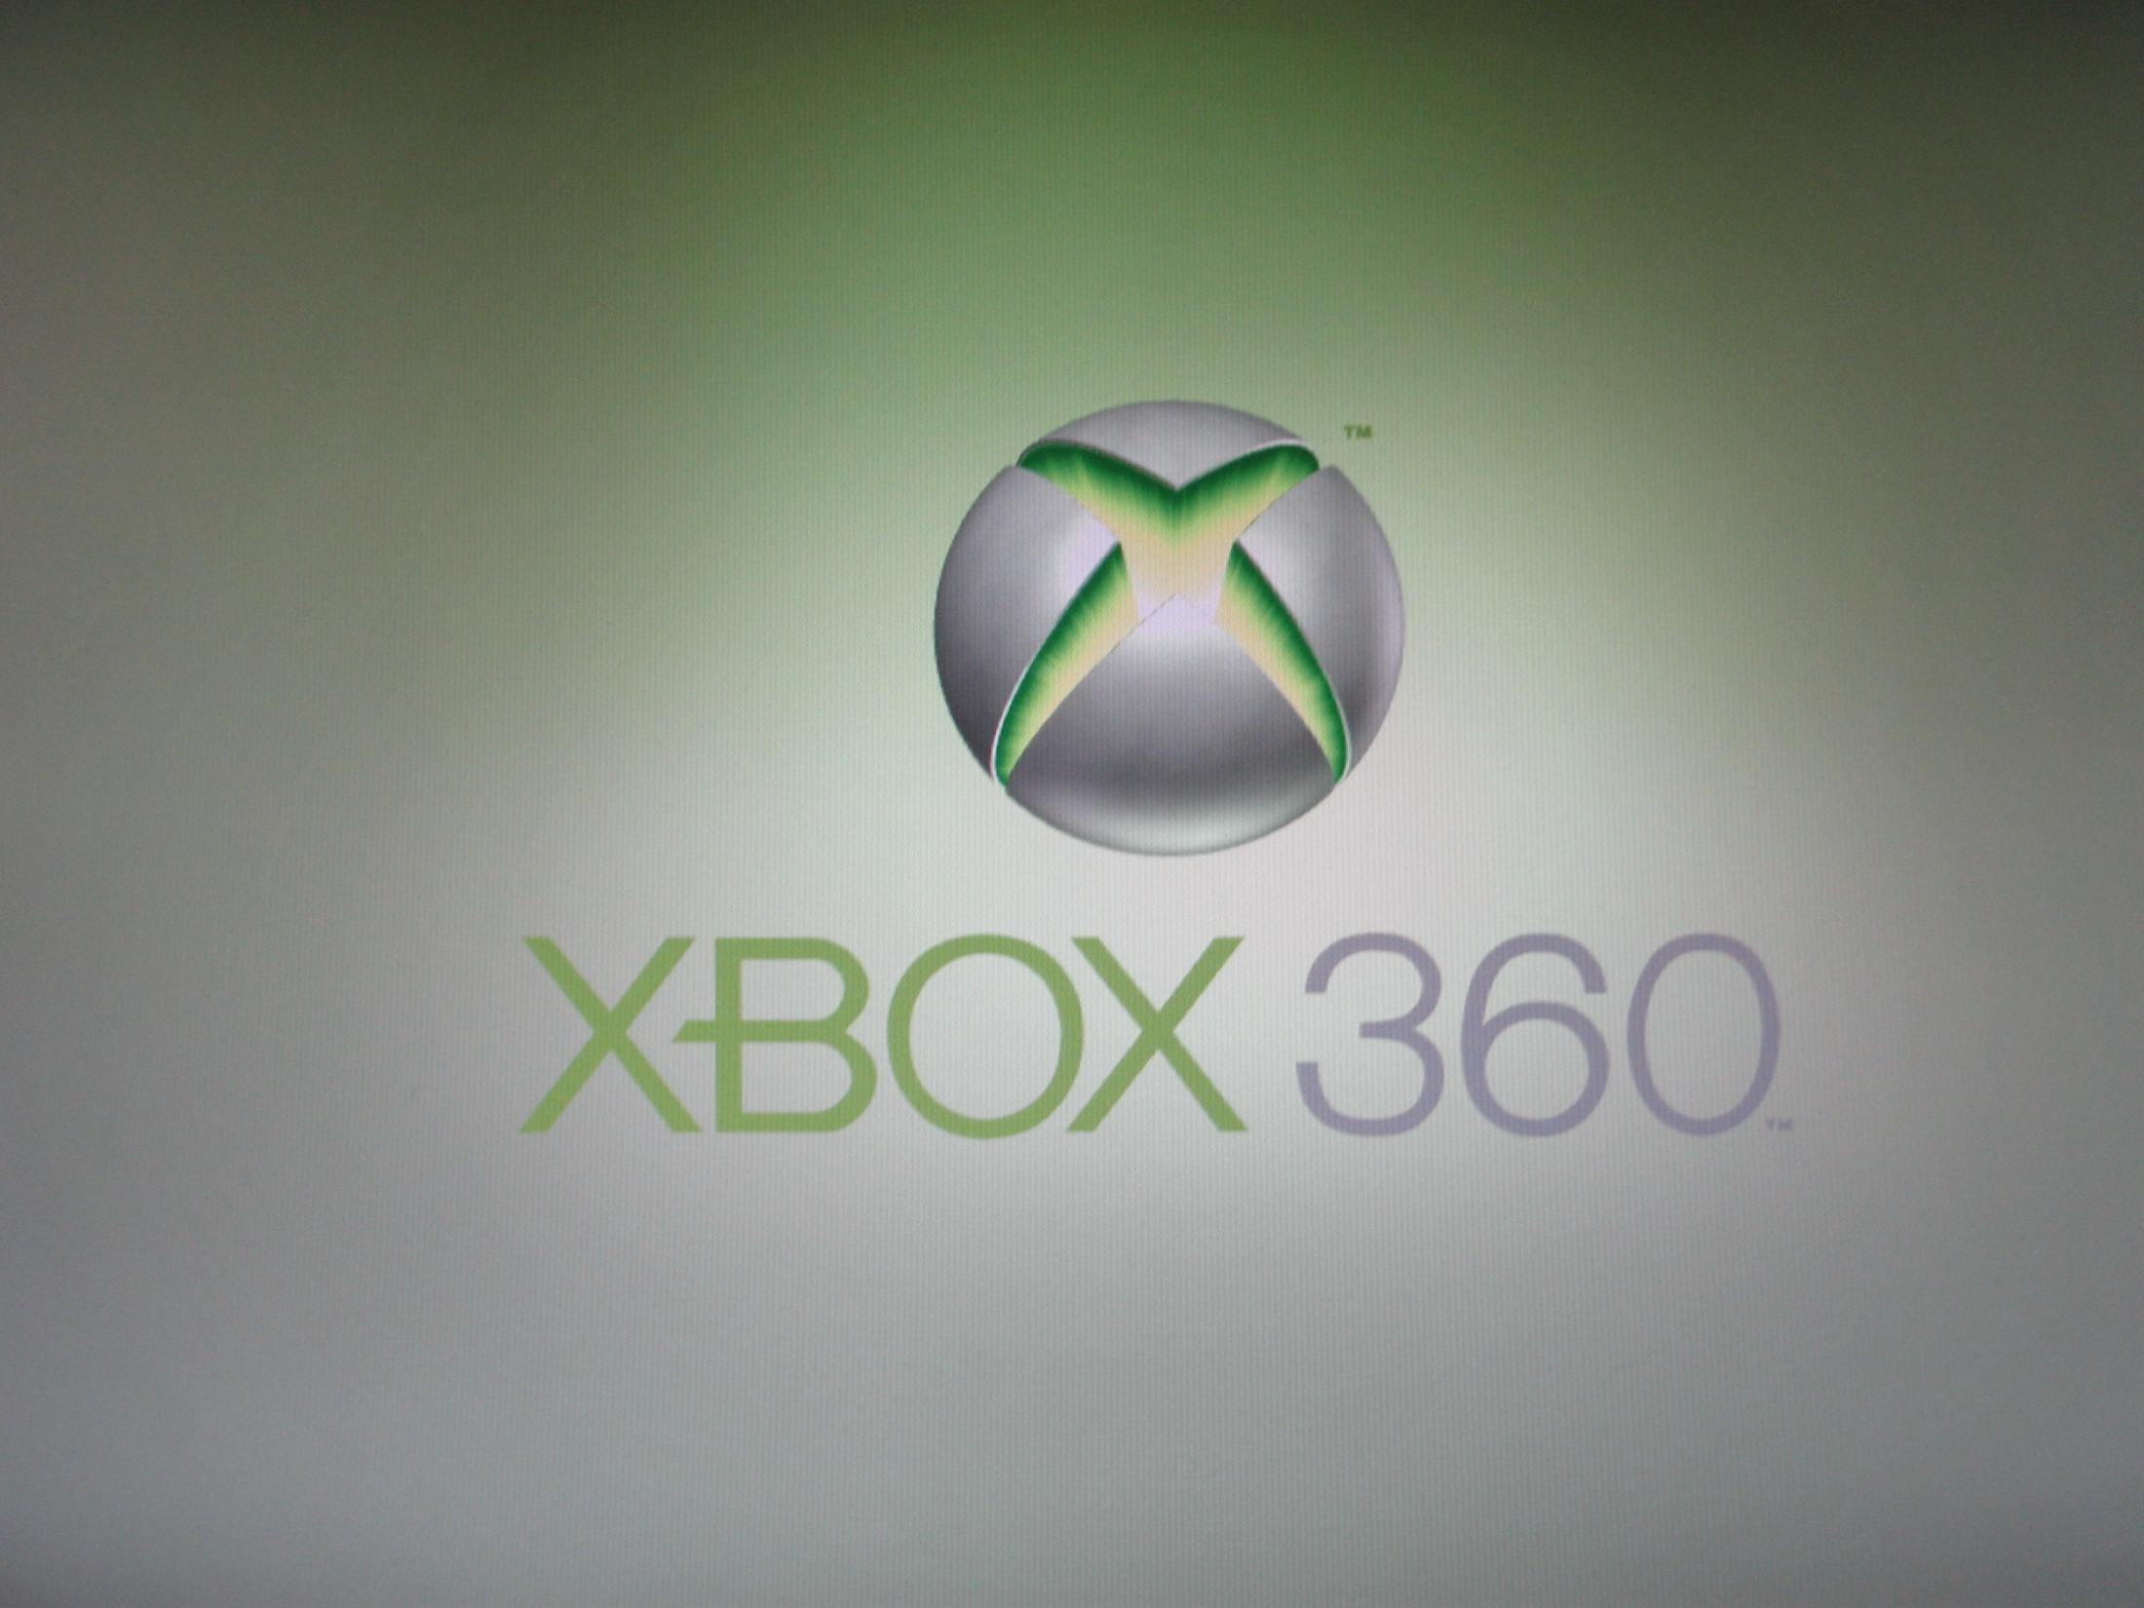
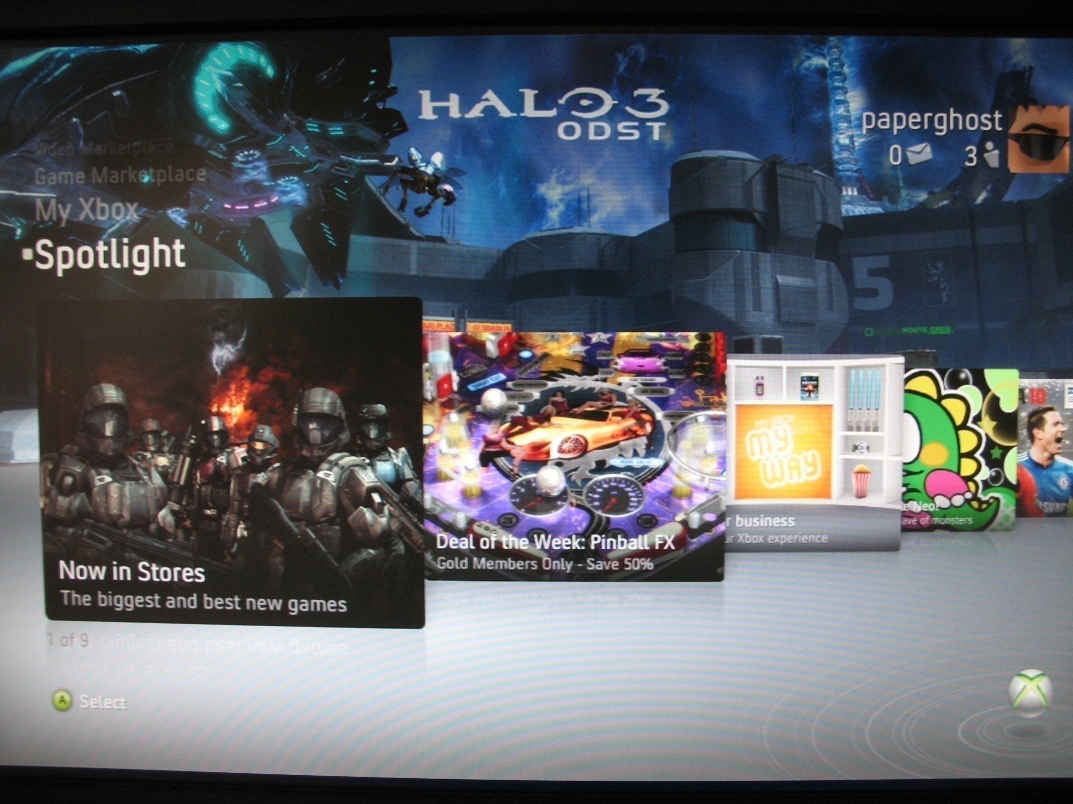
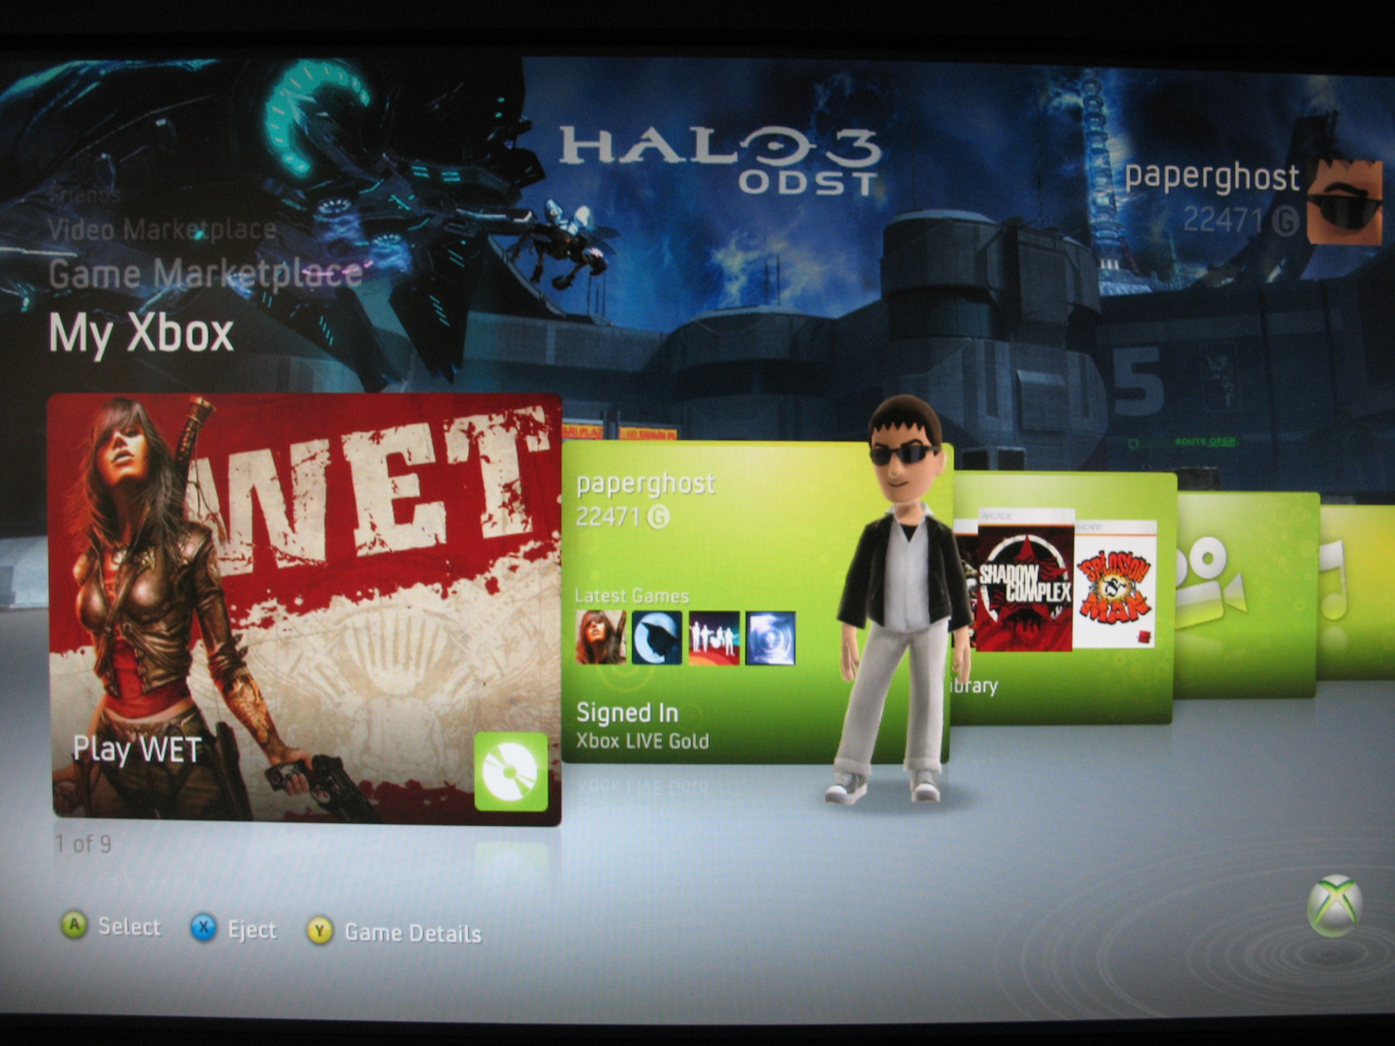
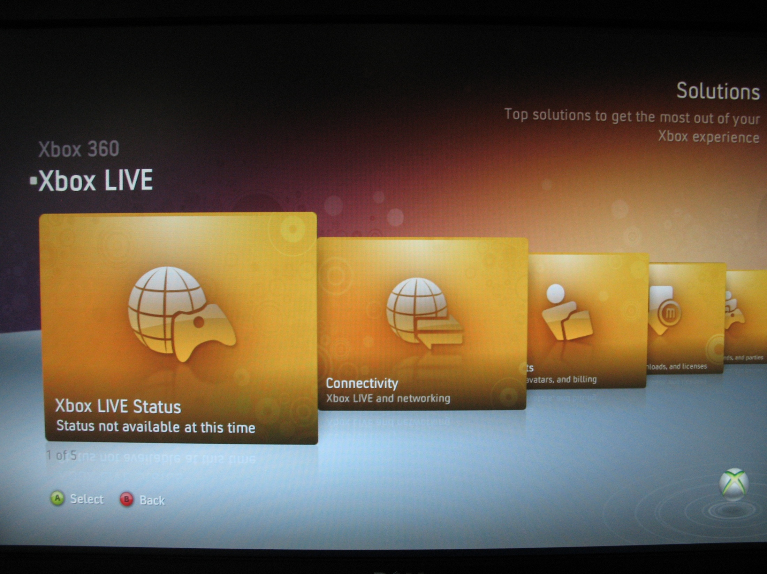

Slide 13
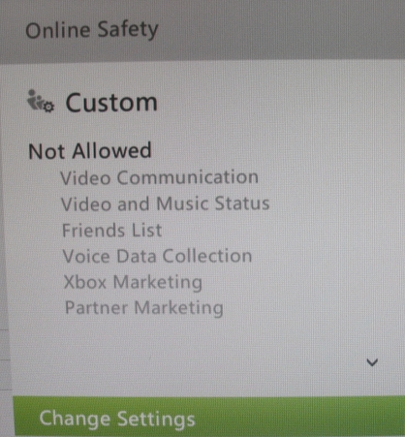

Slide 14
Risk / Reward – but mostly risk
Incentives make you a target
When cc details decrease in value, gaming PII can put the price back up
Gaming accounts an established commodity on the black market

Slide 15
Tools of the Trade

Slide 16
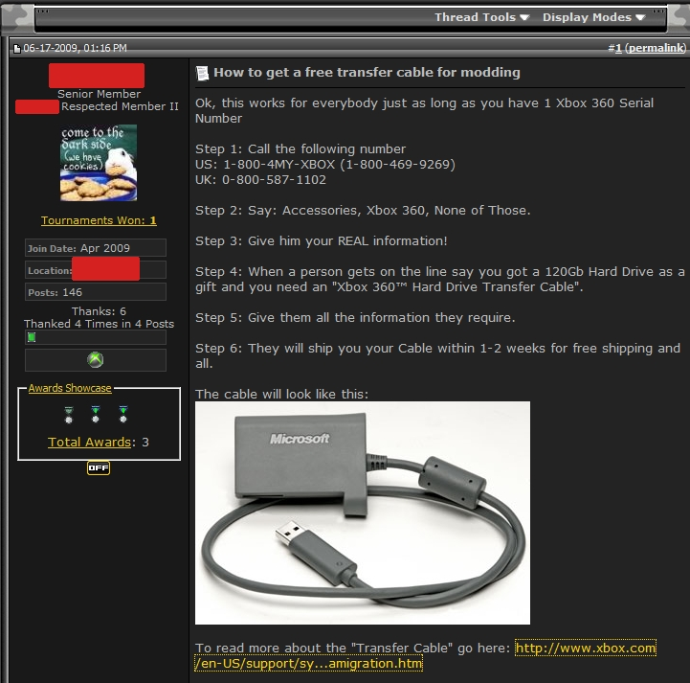
Tools of the Trade

Slide 17
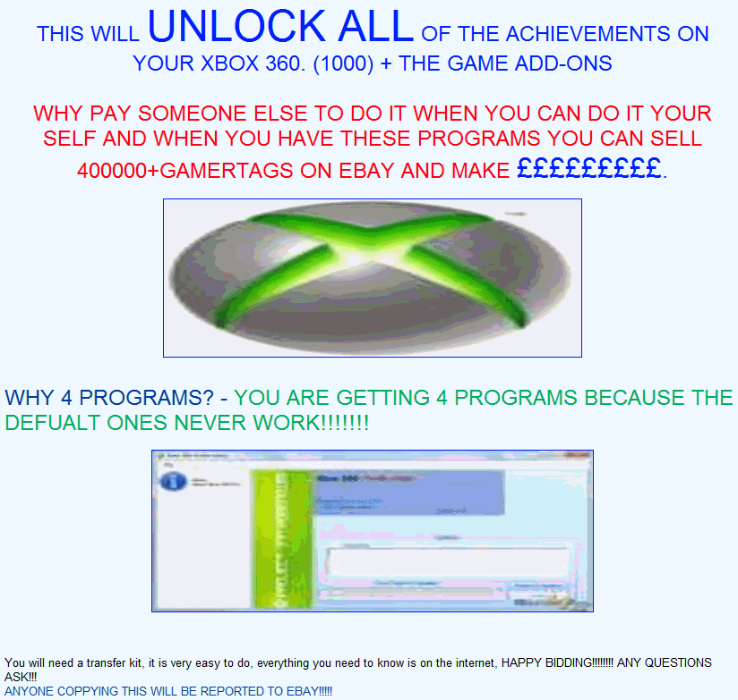
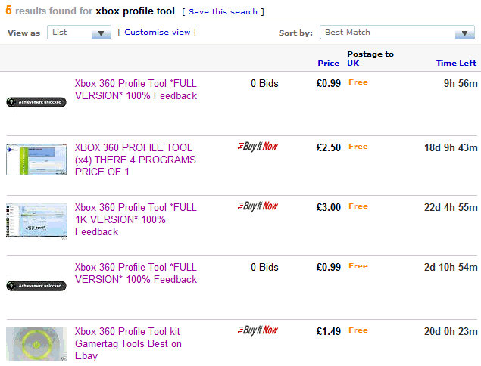

Slide 18
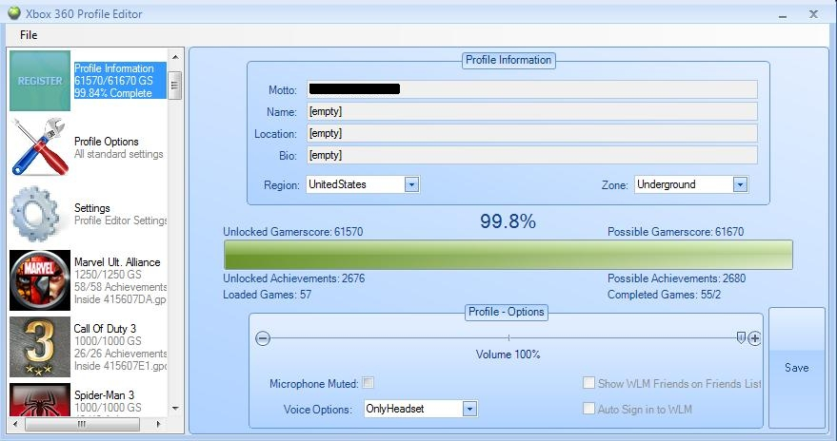
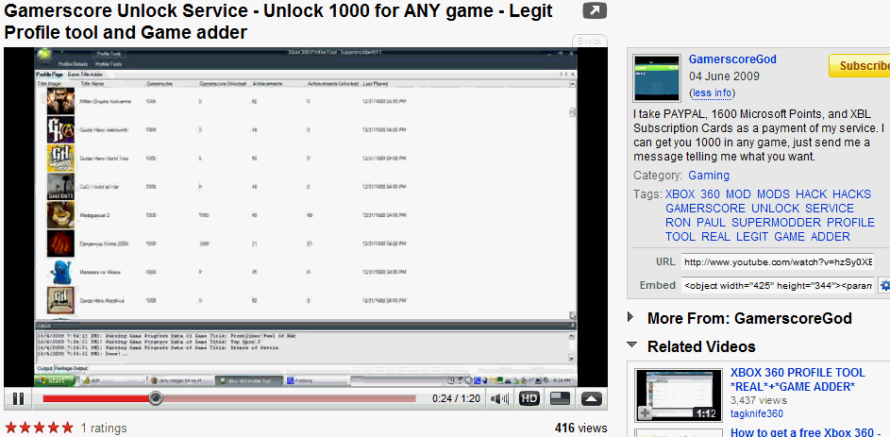
Tools of the Trade

Slide 19
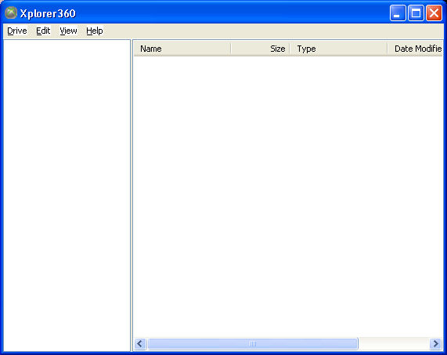
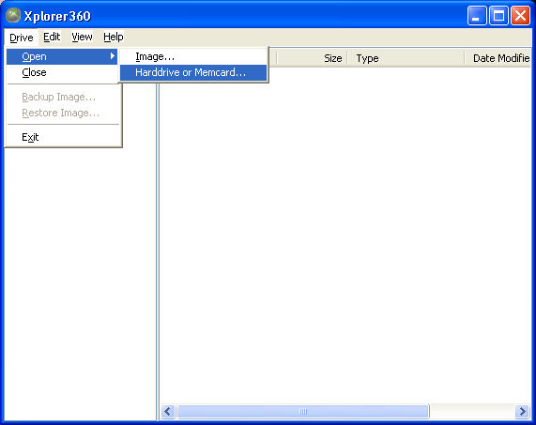
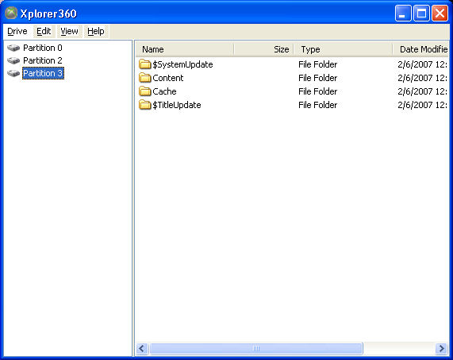
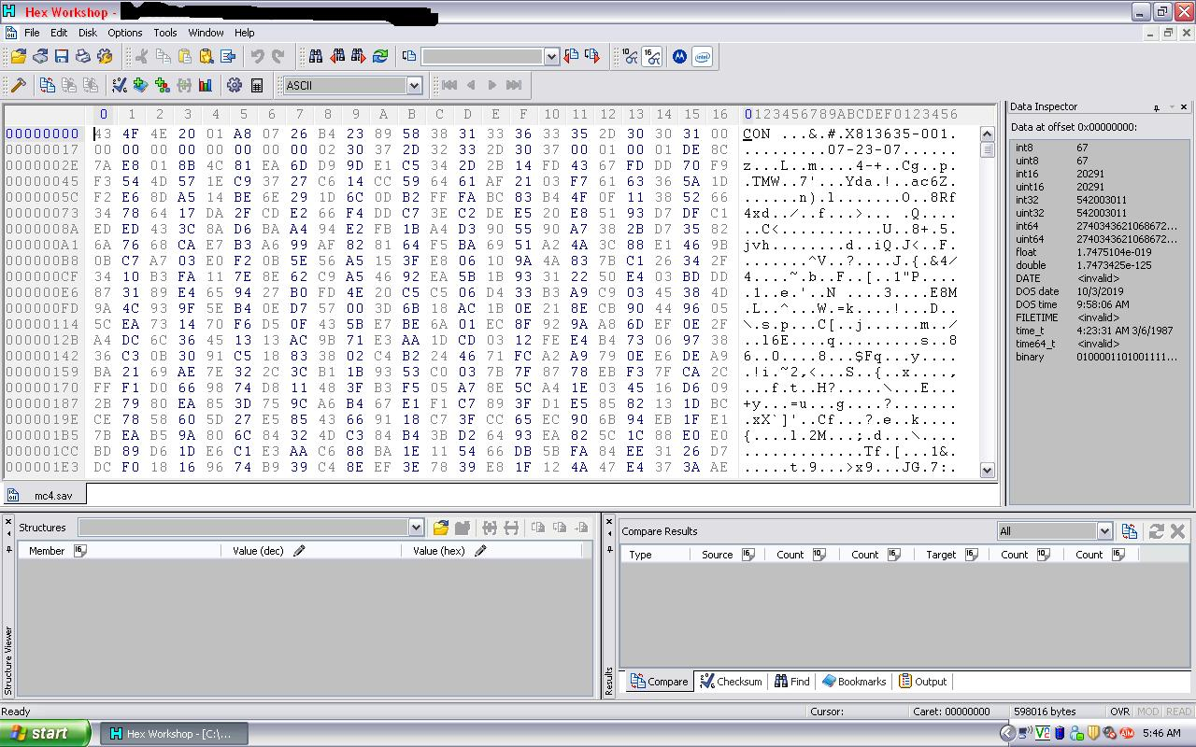
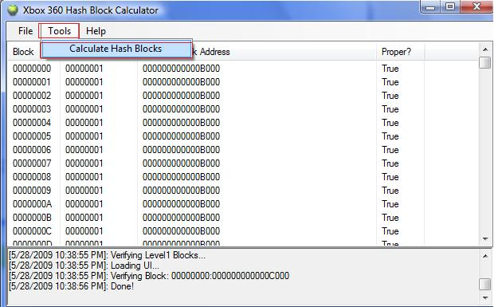


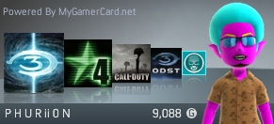
Tools of the Trade

Slide 20
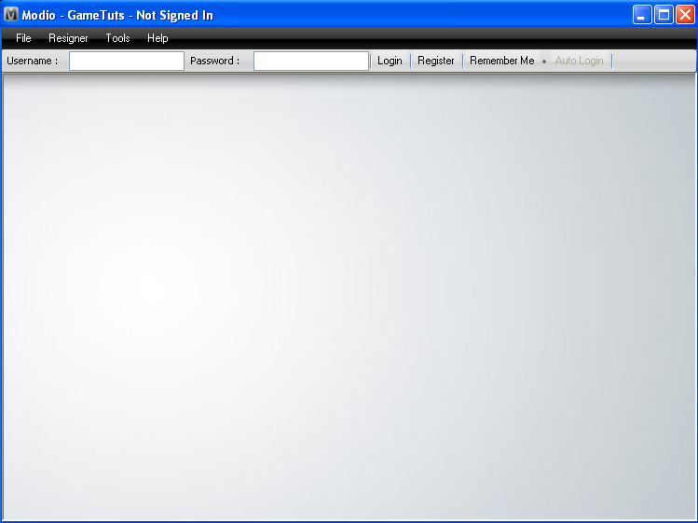
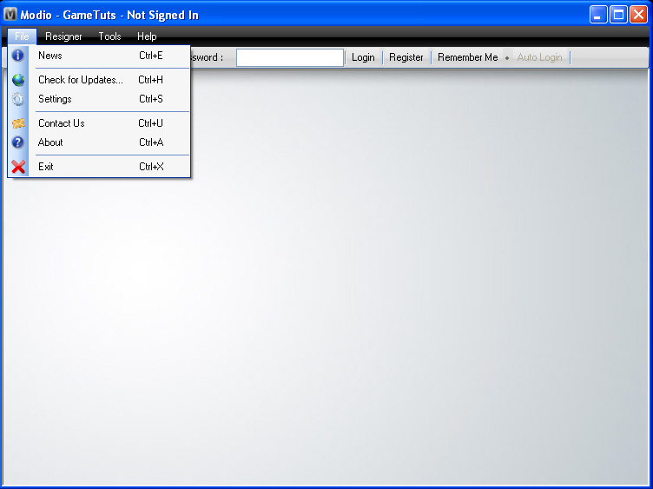
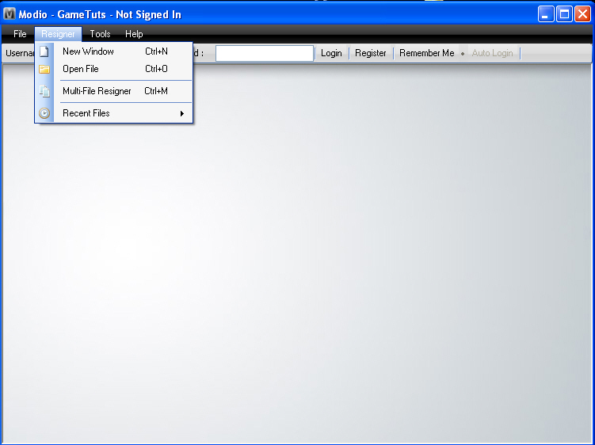
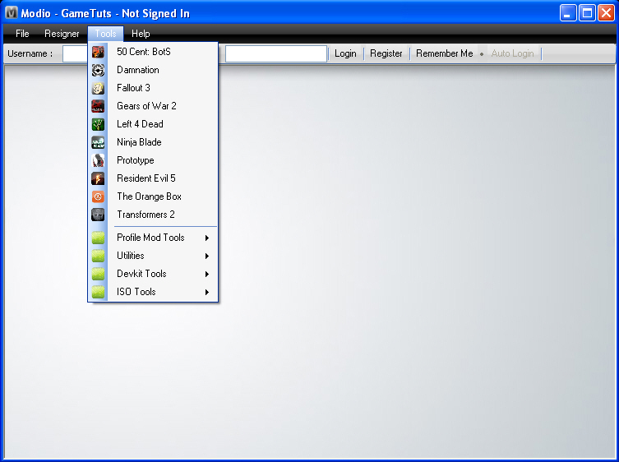
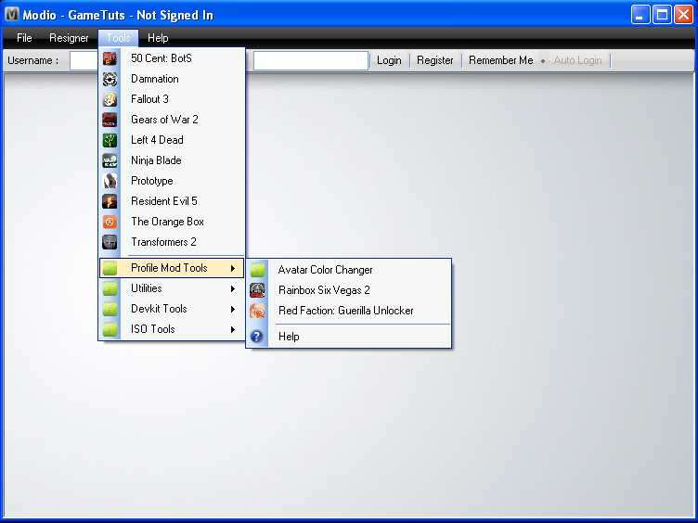
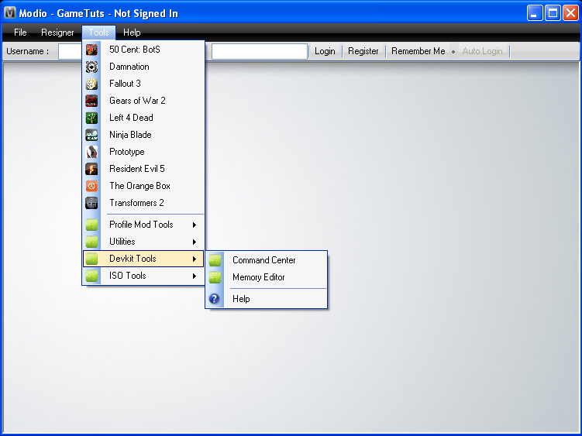
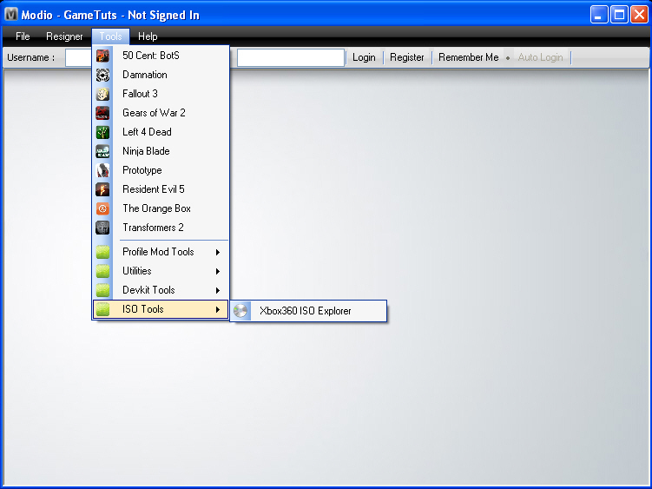
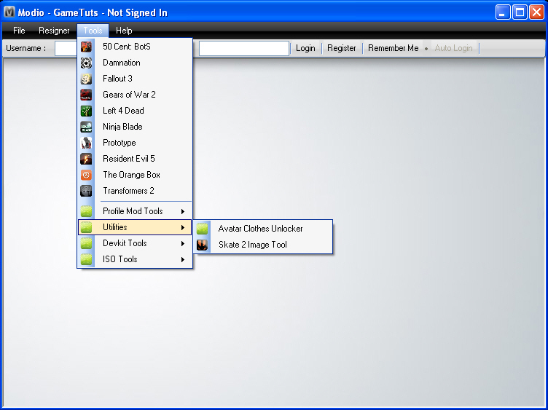
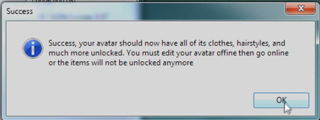
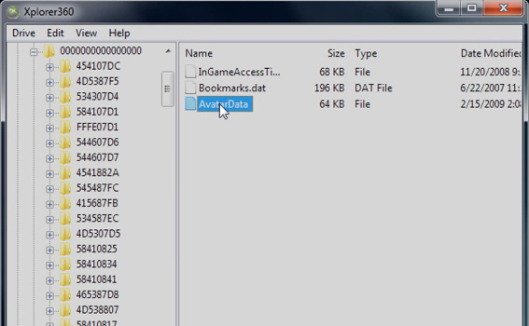
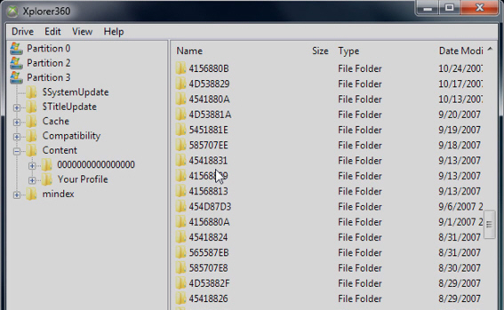
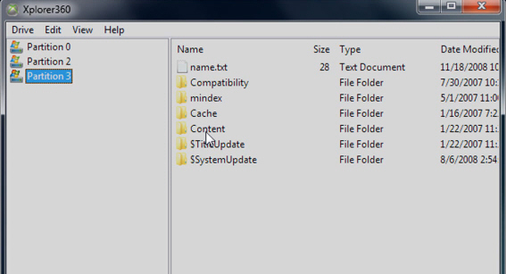
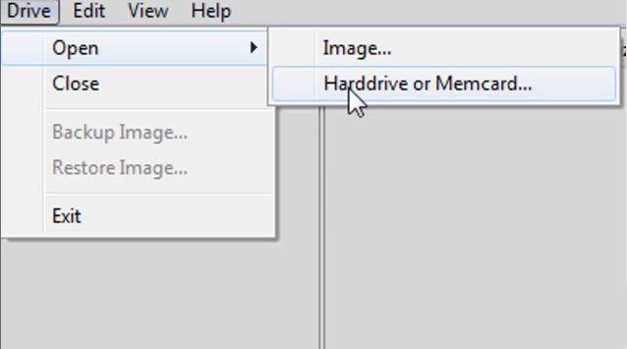

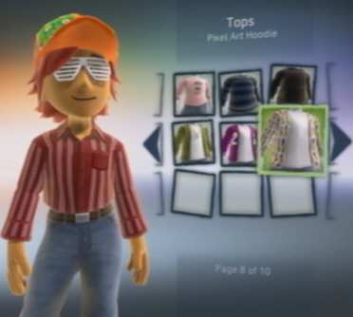

Slide 21
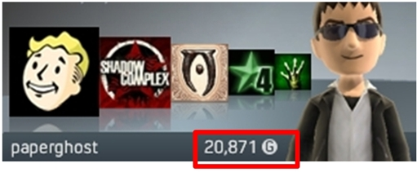
Gamerscore / Trophies
Do well in a game, earn Gamerscore / Trophies
Gamerscore: accumulated Achievement points
The score will only ever go up, giving permanent value to the account

Slide 22
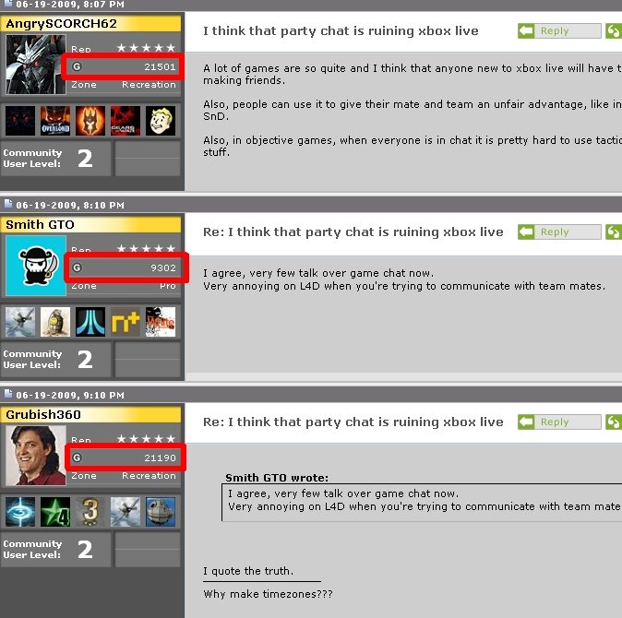

Slide 23
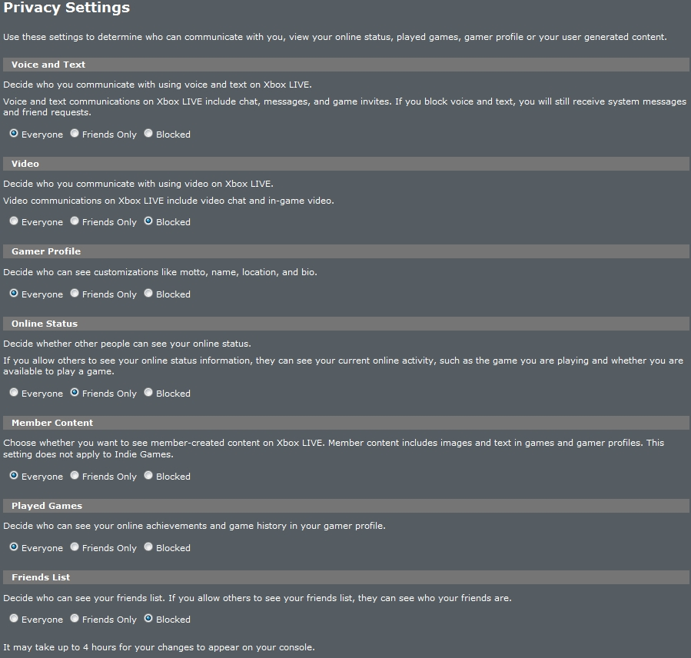
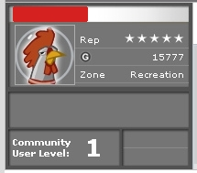

Slide 24
Gamerscore and the Underground Economy

Slide 25
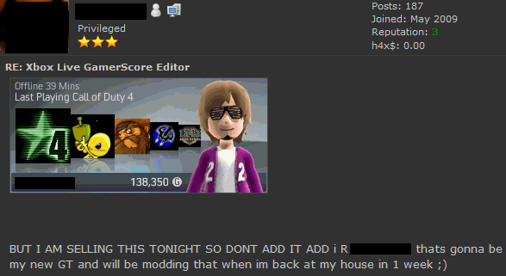
Buying and Selling

Slide 26
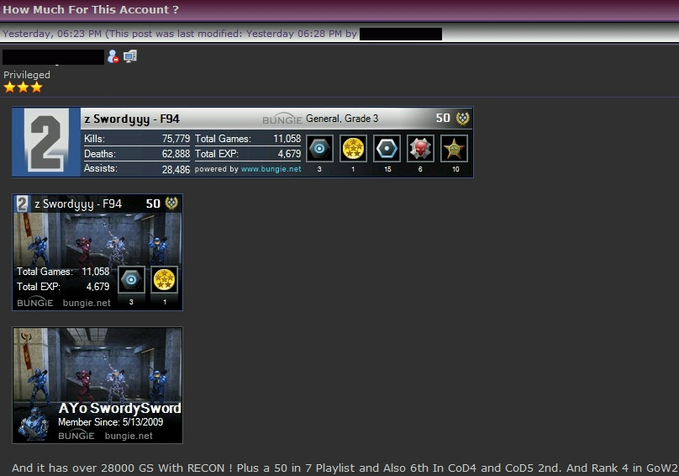
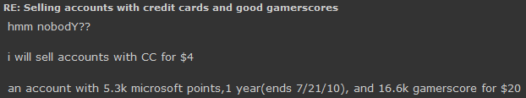
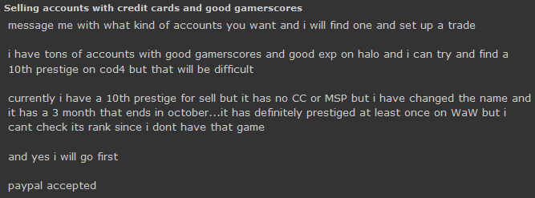

Slide 27
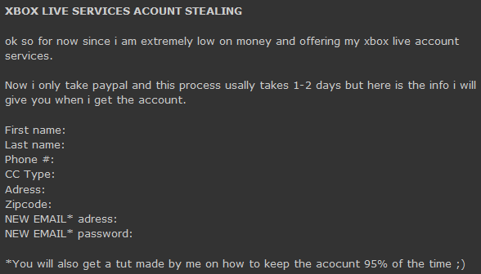

Slide 28
System Exploitation in Game Sessions

Slide 29
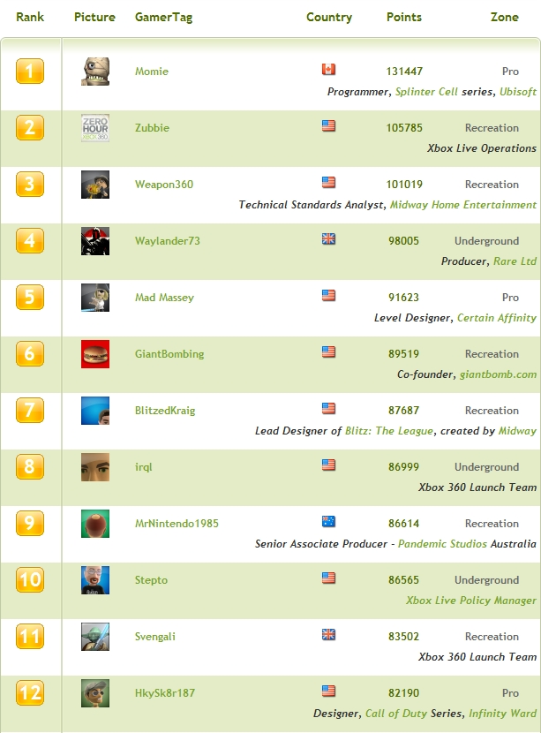
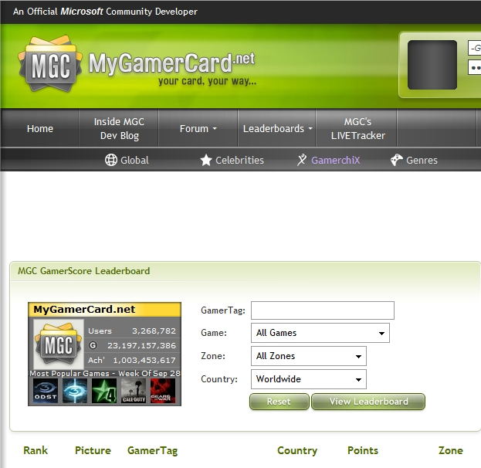
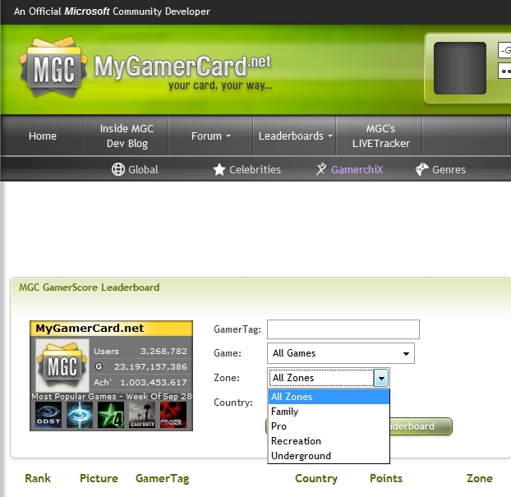

Slide 30
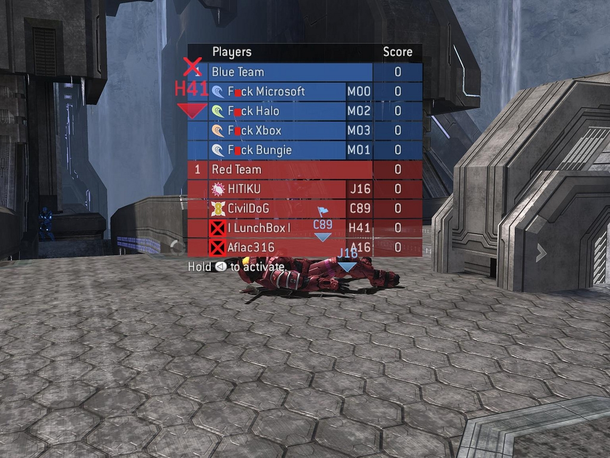




Gamertag hacking

Slide 31

System Exploitation in Game Sessions

Slide 32








System Exploitation in Game Sessions

Slide 33
Social Engineering and Miscellanous Tools

Slide 34

Social Engineering and Miscellaneous Tools

Slide 35








Slide 36


Social Engineering and Miscellaneous Tools

Slide 37



Social Engineering and Miscellaneous Tools

Slide 38



Social Engineering and Miscellaneous Tools

Slide 39






Social Engineering and Miscellaneous Tools

Slide 40
Threats to Business

Slide 41
Threats to Business
survey of 200 senior IT decision-makers in public and private sector organizations around the globe
4 in 10: no idea of the threats posed by consoles
8 in 10: no record of who uses the console
49% have a console in the workplace
44% have a net connected console
48% have a Wii, xbox in 2nd place, PS3 in 3rd.

Slide 42



Threats to Business

Slide 43

Threats to Business

Slide 44
Threats to Business - Solutions
Put someone in charge of console management
Use “Parental Lockout” features to require passwords
Keep a logbook to record who uses it and when
Don’t use your company name in your gaming account
Does the console really need to be online?

Slide 45
The End?

Slide 46
Thank You!
GFI Software
www.gfi.com
GFI Labs Blog:
Sunbeltblog.blogspot.com
Twitter (PH Labs account):
@gfilabsph
Twitter (Personal account):
@paperghost
Marketing / PR Only:
(+63) 917 879 0216

