Slide 1

ROOTCON 101

Slide 2
Agenda
MeH
About
Advocacy
Logistics
Goons
Rules
Activities
Sponsors

Slide 3

MeH
Notes:
I work for…

Slide 4

MeH
AW3S0m3 Stuff
Notes:
I founded

Slide 5

About

Slide 6
About
We define hacking as high form of intelligence in any form, may it be technological breakthrough or household hacking(hacking grandmas toaster, we define hacking as bringing things into its limits with the same usability of certain things.
Notes:
From grandmas toaster to high gadgets

Slide 7



Advocacy

Slide 8

Advocacy
Notes:
Gather and share knowledge

Slide 9

Advocacy

Slide 10

Logistics
Notes:
Our logistics are composed of Planning Stage, Implementation and Execution, we plan months and months before the CON this is to give everyone an awesomeness experience
Planning
a. Venue
b. Activities
c. Campaign

Slide 11

Goons
Notes:
These are the people that making the CON really awesome, with their ninja skills ROOTCON came out with awesomeness and coolness.

Slide 12
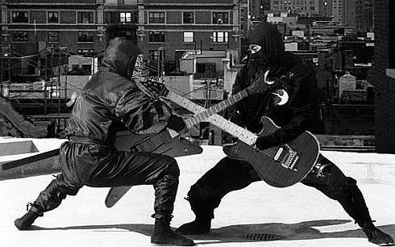
Activities
Notes:
The Core of ROOTCON
We have the following
Hacker Jeopardy
Hacker Exercise
Meet N Greet
Robotics Ninja
WiFi ShootOut
WiFi Warrior
X-Rigs Warrior
If you don’t fit any of those activities you can plan and come your own activity that interests you and your gang, just approach any of the GOONS or ROOTCON organizers and they are very much happy to discuss them.

Slide 13

Rules of ROOTCON
Notes:
Rules of ROOTCON is very simple
Don’t be an ASS
Don’t be a douchebag
Stay Cool – you don’t know the person next right to you, so don’t poke them
Enjoy
Enjoy

Slide 14

Rules of ROOTCON
Notes:
Don’t be an ASS

Slide 15

Rules of ROOTCON
Notes:
Don’t be a douchebag

Slide 16

Rules of ROOTCON
Notes:
Stay Cool

Slide 17

Rules of ROOTCON
Notes:
Enjoy

Slide 18
Activities
Badge Decrypting Contest
CTF (Hackista Challenge)
WiFi Warrior
Treasure Quest
Hackers For Charity
Toolbox
  Wireless
  Hardware
  IPv6
Notes:
Enjoy

Slide 19
Activities
  The Badge Decrypting Contest
  QR CODE
I scan I detect I hack
Notes:
Enjoy

Slide 20
Milestone
More Activities
More Talks
More con-goer interaction
More FUN
More BEER

Slide 21

Sponsors
Notes:
The people that keeps ROOTCON sustainable, these people has been very good to us for making ROOTCON an awesome hacker conference in the country

Slide 22

Sponsors

Slide 23

Sponsors

Slide 24

Sponsors

Slide 25

Sponsors

Slide 26

Sponsors

Slide 27

Sponsors

Slide 28

Sponsors

Slide 29

Sponsors

Slide 30

Sponsors

Slide 31





Media Partners

Slide 32

APPLAUSE TO OUR SPONSORS

Slide 33
2-3 Questions

