Slide 1
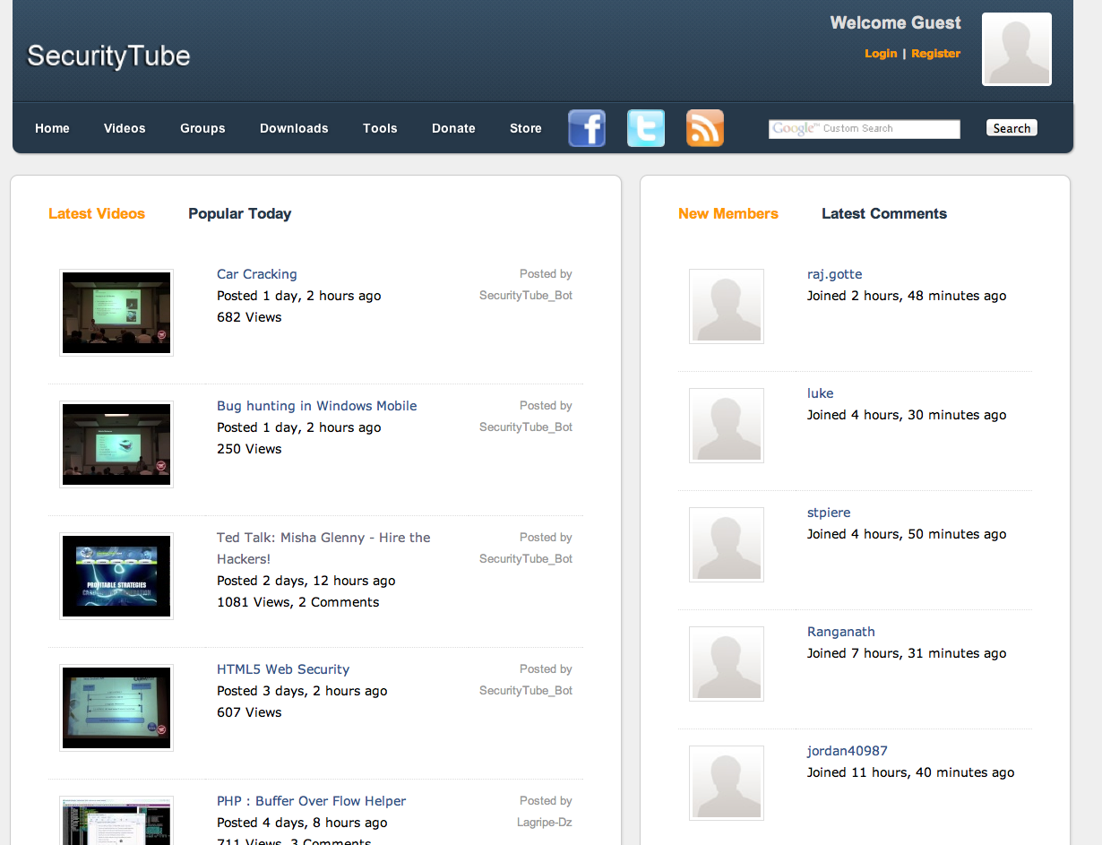
Enterprise Wi-Fi Worms, Backdoors and Botnets for Fun and Profit
Vivek Ramachandran
Founder, SecurityTube.net

Slide 2

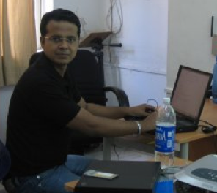
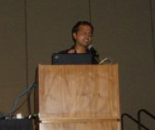
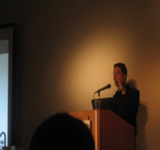

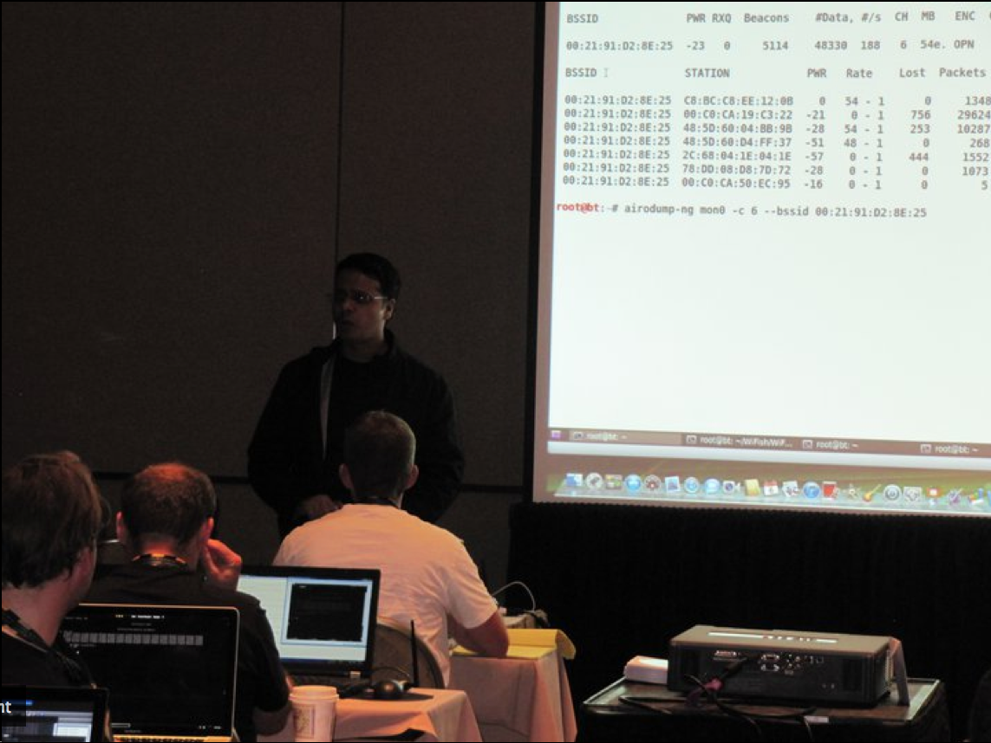
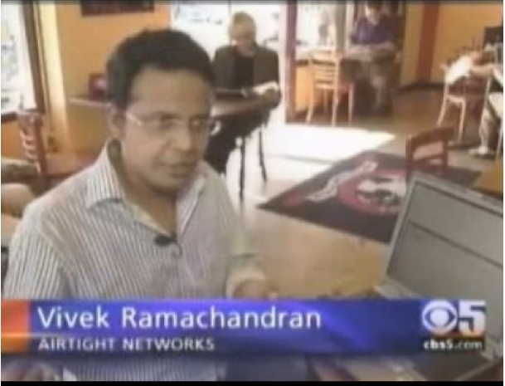

Vivek Ramachandran
B.Tech, ECE
IIT Guwahati
802.1x, Cat65k
Cisco Systems
WEP Cloaking
Defcon 15
Caffe Latte Attack
Toorcon 9
Media Coverage
CBS5, BBC
Trainer, 2011
Microsoft
Security Shootout
Wi-Fi Malware, 2011

Slide 3
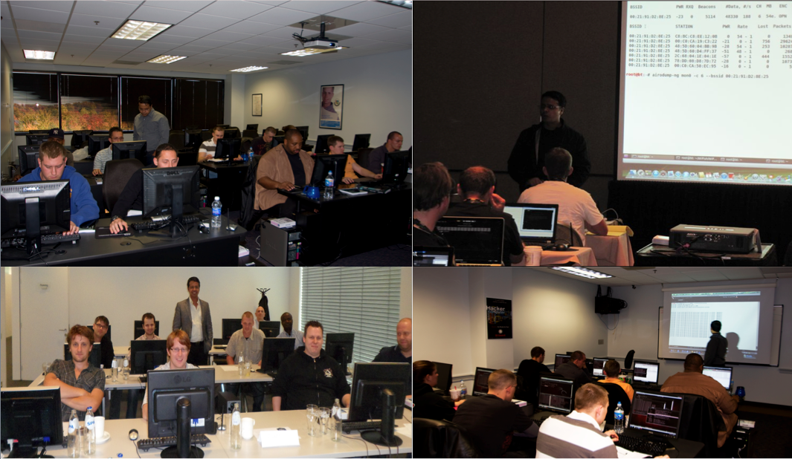
In-Person Trainings

Slide 4


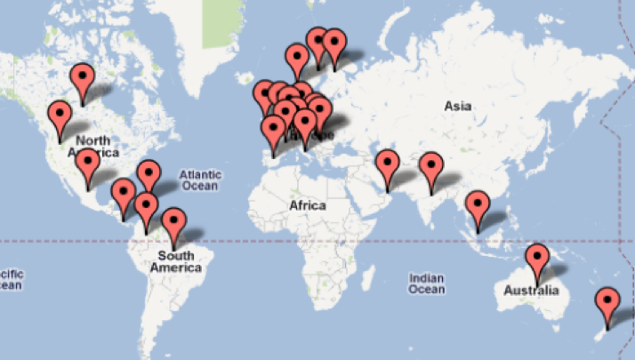
SecurityTube Online Certifications
25+ Countries

Slide 5
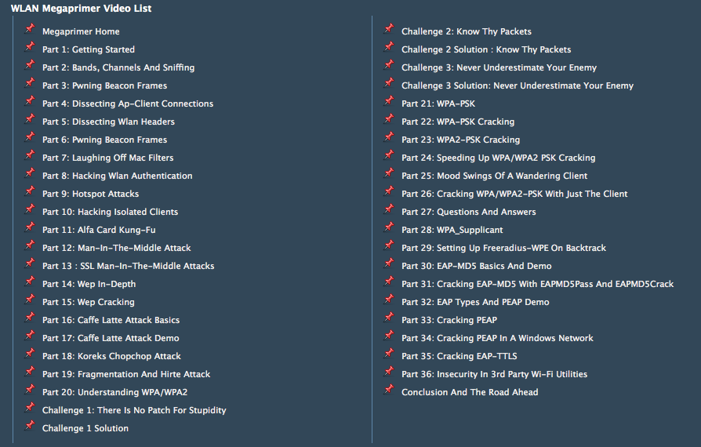
Free DVD (12+ Hours of HD Videos)
http://www.securitytube.net/downloads

Slide 6
Enterprise Wi-Fi Worms, Backdoors and Botnets for Fun and Profit
Vivek Ramachandran
Founder, SecurityTube.net

Slide 7
Objective
How Malware could leverage Wi-Fi to create
  Backdoors
  Worms
  Botnets

Slide 8
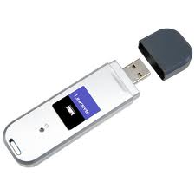
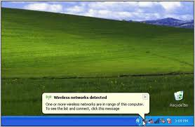
Background – Understanding Wi-Fi Client Software
Allows Client to connect to an Access Point
First time user approves it, Auto-Connect for future instances
Details are stored in Configuration Files

Slide 9
Command Line Interaction?
Scanning the air for stored profiles
Profiling the clients based on searches
Different clients behave differently
Demo

Slide 10
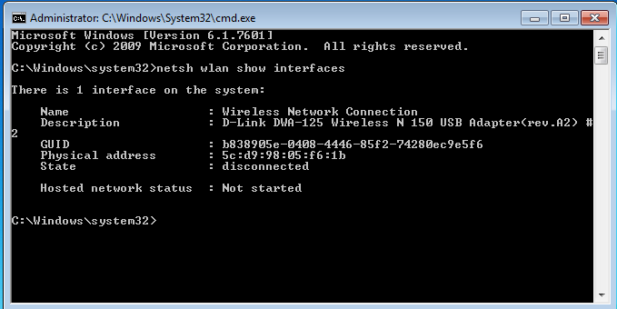
See All Wi-Fi Interfaces
Netsh wlan show interfaces

Slide 11
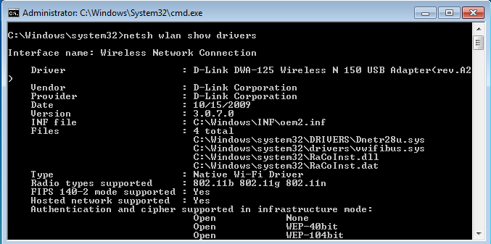
Drivers and Capabilities
Netsh wlan show drivers

Slide 12
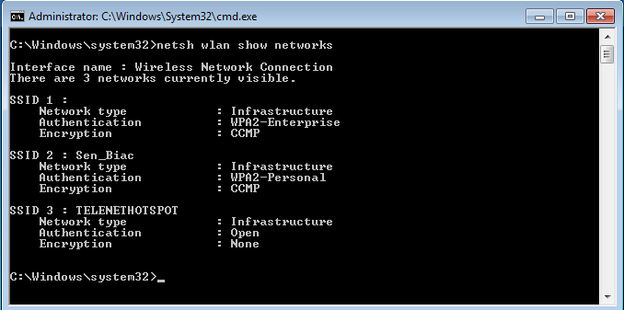
Scan for Available Networks
Netsh wlan show networks

Slide 13
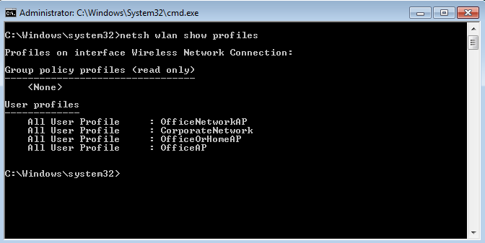
View Existing Profiles
Netsh wlan show profiles

Slide 14
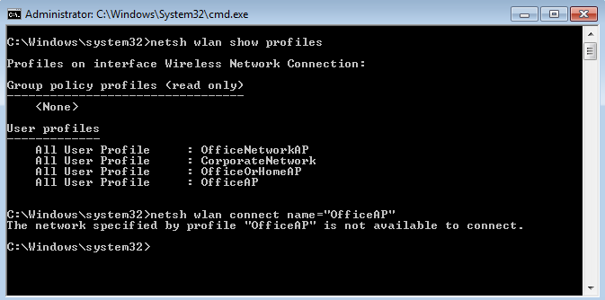
Starting a Profile
Netsh wlan connect name=“vivek”

Slide 15
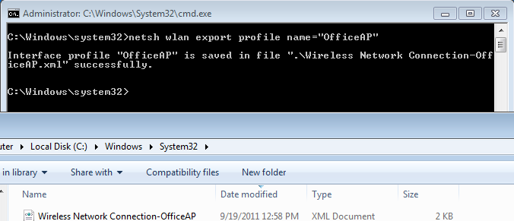
Export a Profile
Netsh wlan export profile name=“vivek”

Slide 16

Creating an Access Point on a Client Device
Requirement for special drivers and supported cards
Custom software used – HostAPd, Airbase-NG
More feasible on Linux based systems

Slide 17
Generation 2.0 of Client Software – Hosted Network
Available Windows 7 and Server 2008 R2 onwards
Virtual adapters on the same physical adapter
SoftAP can be created using virtual adapters
  DHCP server included
“With this feature, a Windows computer can use a single physical wireless adapter to connect as a client to a hardware access point (AP), while at the same time acting as a software AP allowing other wireless-capable devices to connect to it.”
http://msdn.microsoft.com/en-us/library/dd815243%28v=vs.85%29.aspx

Slide 18
Feature Objective
To allow creation of a wireless Personal Area Network (PAN)
  Share data with devices
Network connection sharing (ICS) with other devices on the network

Slide 19
Demonstration
Demo of Hosted Network

Slide 20
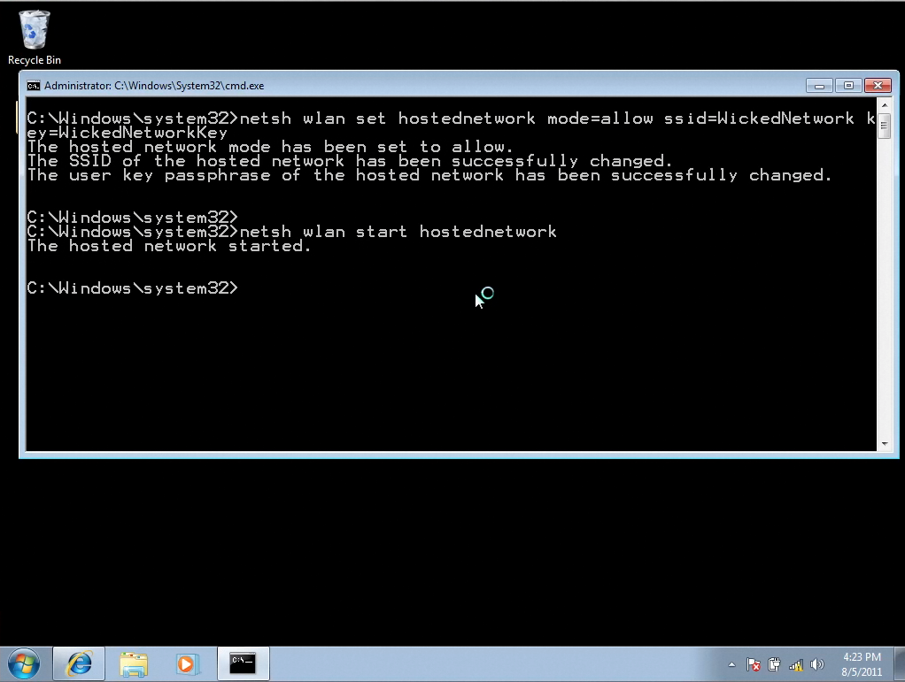
Creating a Hosted Network

Slide 21
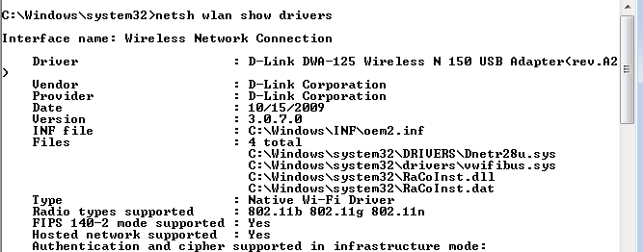
Driver Support

Slide 22
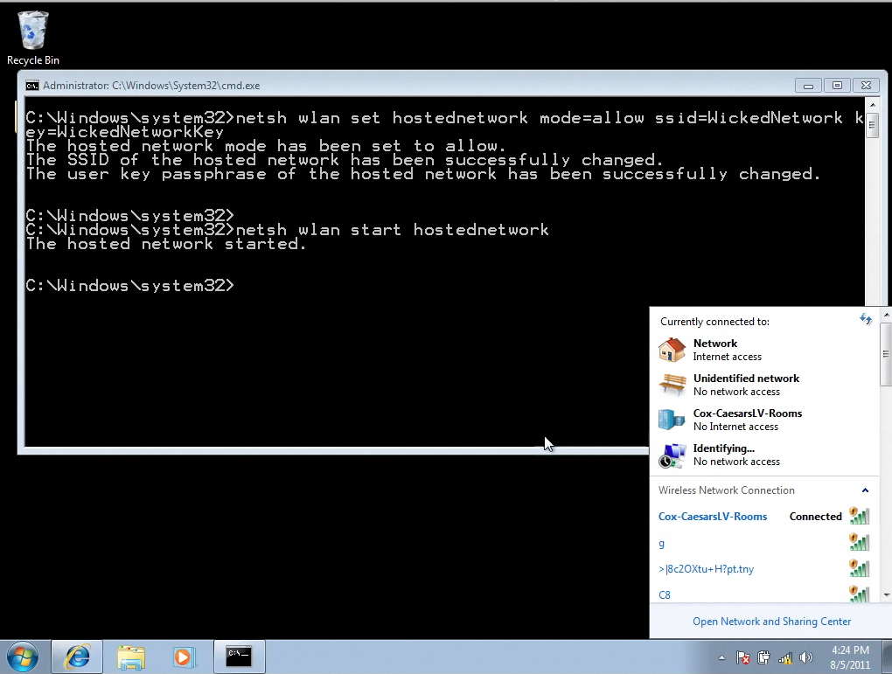
Client still remains connected to hard AP!

Slide 23
Wi-Fi Backdoor
Easy for malware to create a backdoor
They key could be:
  Fixed
  Derived based on MAC address of host, time of day etc.
As host remains connected to authorized network, user does not notice a break in connection
No Message or Prompt displayed

Slide 24


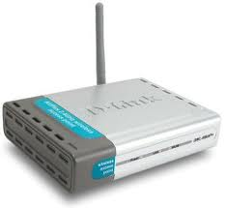

Understanding Rogue Access Points
Rogue AP

Slide 25
Makes a Rogue AP on every Client!
Rogue AP
Rogue AP
Rogue AP

Slide 26
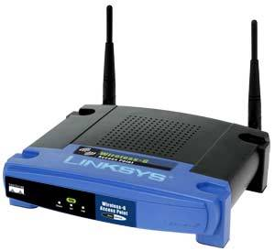
Best Part – No Extra Hardware!

Slide 27


Advantages?
Internet

Slide 28
Advantages?
Internet
Wicked Network

Slide 29
Why is this cool?
Victim will never notice anything unusual unless he visits his network settings
  has to be decently technical to understand
Attacker connects to victim over a private network
  no wired side network logs: firewalls, IDS, IPS
  Difficult, if not impossible to trace back
  Difficult to detect even while attack is ongoing ☺
Abusing legitimate feature, not picked up by AVs, Anti-Malware
More Stealth? Monitor air for other networks, when a specific network comes up, then start the Backdoor

Slide 30
Chaining Hosted Networks like a proxy?
Each node has client and AP capability
We can chain them to “hop” machines
Final machine can provide Internet access
Like Wi-Fi Repeaters

Slide 31

Chaining Infected Laptops
AP
Client
AP
Client
AP
Client
Authorized
AP

Slide 32
Package Meterpreter for full access?
Once attacker connects to his victim, he would want to have access to everything
Why not package a Meterpreter with this? ☺
How about a Backdoor post-exploitation script for Metasploit? ☺

Slide 33
Demo
Coupling Hosted Network with Metasploit

Slide 34
Increasing Stealth
Passive Monitoring for SSIDs available
Trigger SSID causes Wicked Hosted Network to start and create application level backdoor
Attacker connects and does his job
Shuts off Trigger SSID and Malware goes to Passive Monitoring again

Slide 35
Karmetasploit
Victim connects by mistake or misassociation
Victim opens browser, Metasploit Browser_Autopwn exploits the system
Hacker gets access!
Biggest Challenge – Victim notices he is connected to the wrong network and disconnects himself

Slide 36
Enhancing Karmetasploit
Upon Exploitation, create the hosted network backdoor
User disconnects, but this hosted network still remains active
Attacker connects via this network

Slide 37

What about older clients and other OSs?
Windows < 7, Mac OS do not have the Hosted Network or alike feature
  Use Ad-Hoc networks
  Use Connect Back mechanism ☺
    When a particular SSID is seen, connect to it automatically
    Blurb reporting “Connected to ABC”
      Could we kill it? ☺

Slide 38
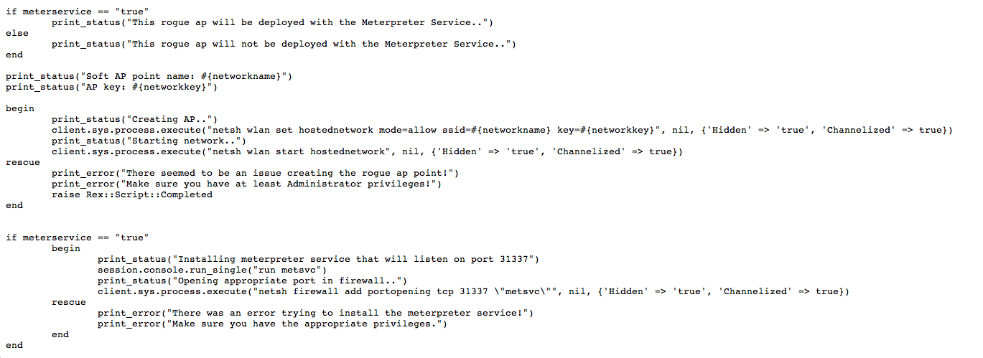
Hosted Network Meterpreter Scripts
http://zitstif.no-ip.org/meterpreter/rogueap.txt
http://www.digininja.org/projects.php

Slide 39

Dissecting Worm Functionality
Propagation
Technique
Worm
Exploit

Slide 40
Hosted Network Encryption
Uses WPA2-PSK for encryption
Key is encrypted in configuration file
Can be decrypted ☺
What if there is an office network configured on the same machine with WPA2-PSK?

Slide 41


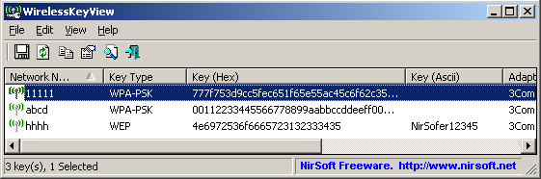
1. Infect Authorized Computer and Decrypt Passphrase

Slide 42
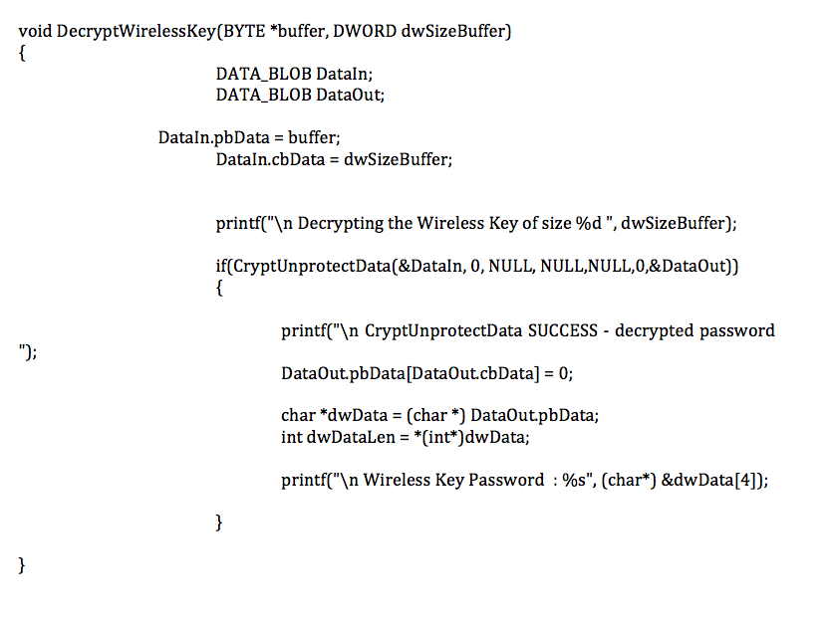
Decryption Routine

Slide 43
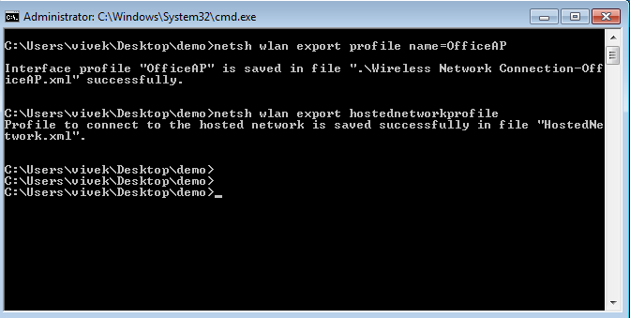
Alternate – Dump and Copy

Slide 44
2. Create a Soft Access Point with the same Credentials
OfficeAP
OfficeAP
Worm Infected Laptop

Slide 45
3. Signal Strength Game
OfficeAP
OfficeAP
Worm Infected Laptop

Slide 46
4. Hop and Exploit
OfficeAP
Exploit

Slide 47
5. Replicate and Spread
OfficeAP
OfficeAP

Slide 48


Worms Wi-Fi Network Signal Strength > AP
OfficeAP
OfficeAP
OfficeAP
OfficeAP
OfficeAP

Slide 49
Wi-Fi Worm
Retrieve the network key for the network
Create a hosted network with the same name
When the victim is in the vicinity of his office, worm can be activated
At some point the signal strength may be higher than real AP
Other colleagues laptops may hop and connect
  Conference rooms, Coffee and Break areas

Slide 50
Why is this interesting?
Worm uses its own private Wi-Fi network to propagate
Does not use the Wired LAN at all
Difficult for network defenses to detect and mitigate ☺
Targeted APT against an Enterprise

Slide 51
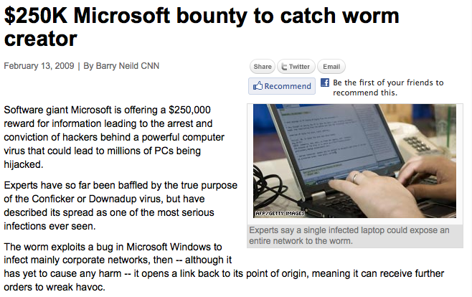
Demo

Slide 52



On the Run ☺

Slide 53
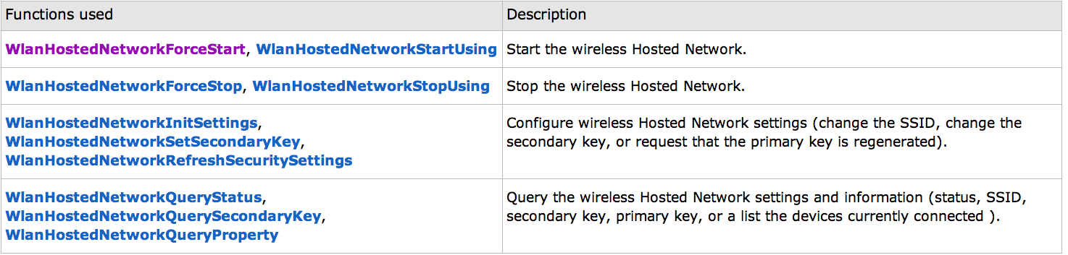
APIs for the Hosted Network Feature

Slide 54
Questions
Questions?

Slide 55
Enterprise Wi-Fi Worms, Backdoors and Botnets for Fun and Profit
Thank You!

