Slide 1
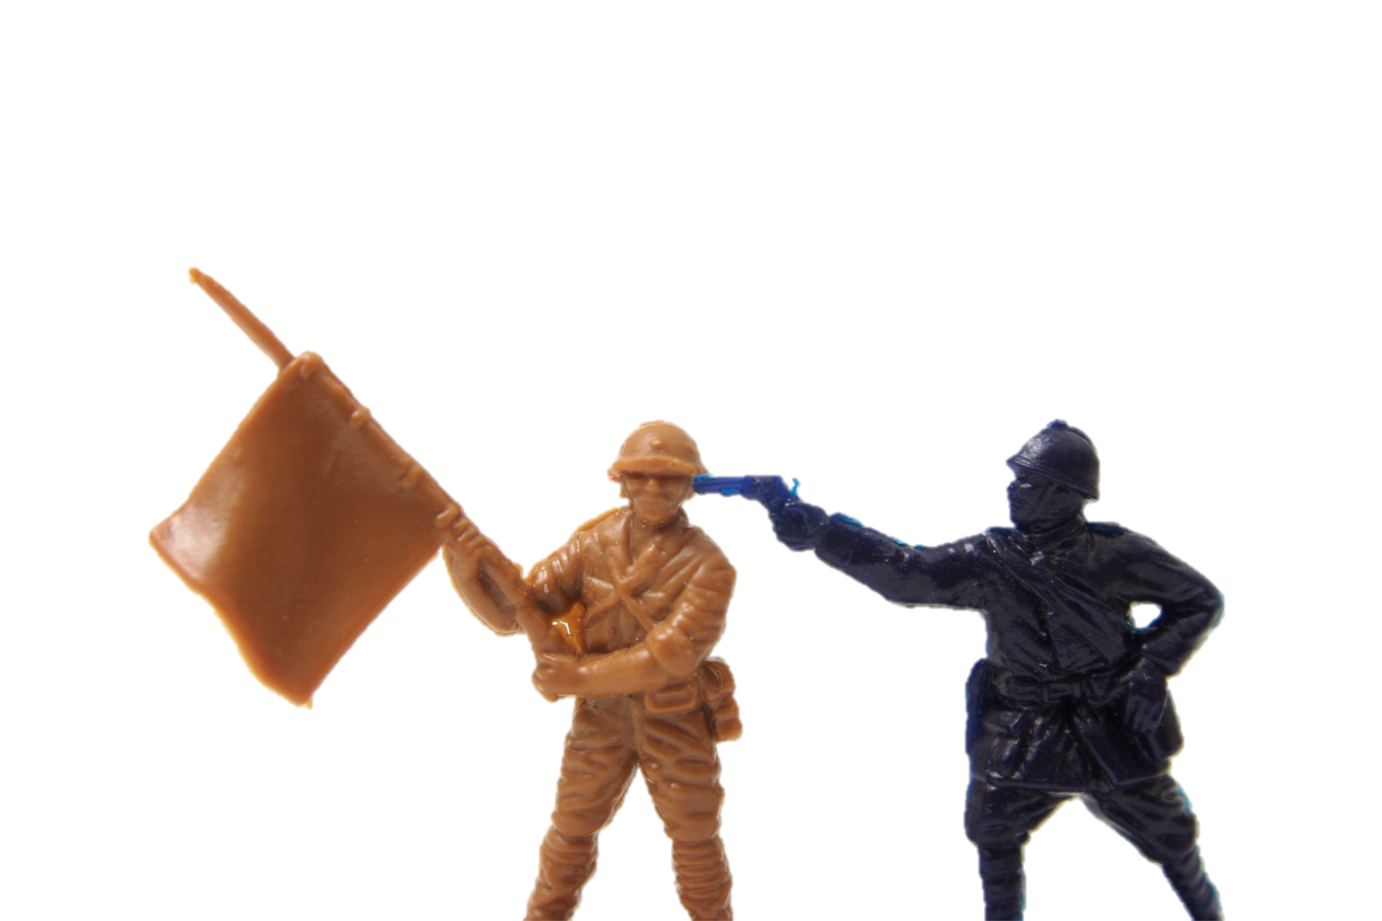
Capture The Flag
An Introduction
Image © http://www.flickr.com/photos/janramroth/2264184078/

Slide 2
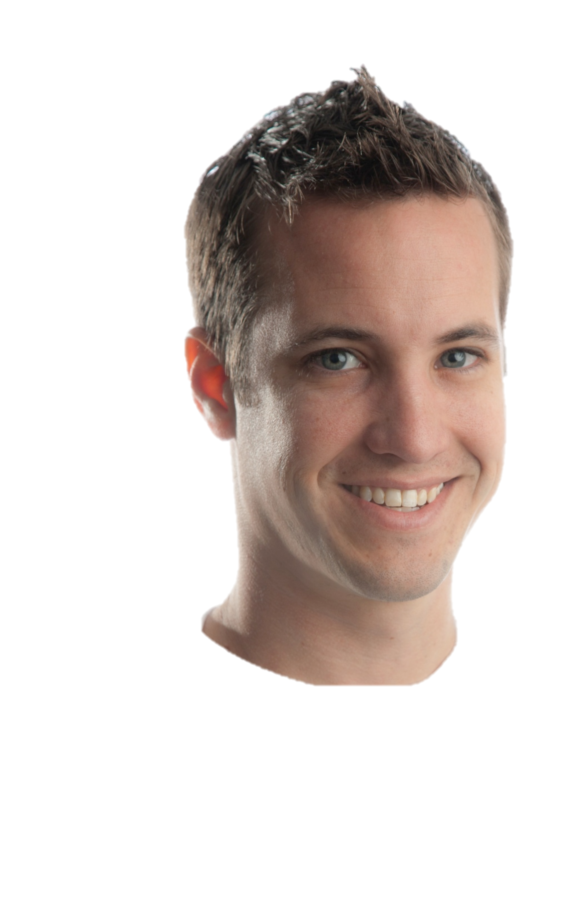


Me
Jordan Wiens
jordan@psifertex.com
@psifertex
Day: Work for The Man
Night: Hack for The Fun
Notes:
Likes: Presenting, NERFing, hacking, CTFing, Parenting, Husbanding (not husbandring!)

Slide 3
Outline
What’s CTF?
Why CTF?
Playing CTF?
Running CTF?

Slide 4
What’s CTF?

Slide 5

Capture the _ _ _ _
Image © http://www.flickr.com/photos/mom320/2332456130/
Notes:
Fun. First, if preaching to the choir, my apologies. For those that aren’t convinced? Why do I like playing CTFs? Because hacking is fun. CTF is basically a hacking game. If you like solving puzzles, if you like solutions no one’s ever thought of before, if you like doing things most folks assume are impossible, then you will too.

Slide 6
Jargon File
flag
key
SLA
service
binary
quals
prequals

Slide 7
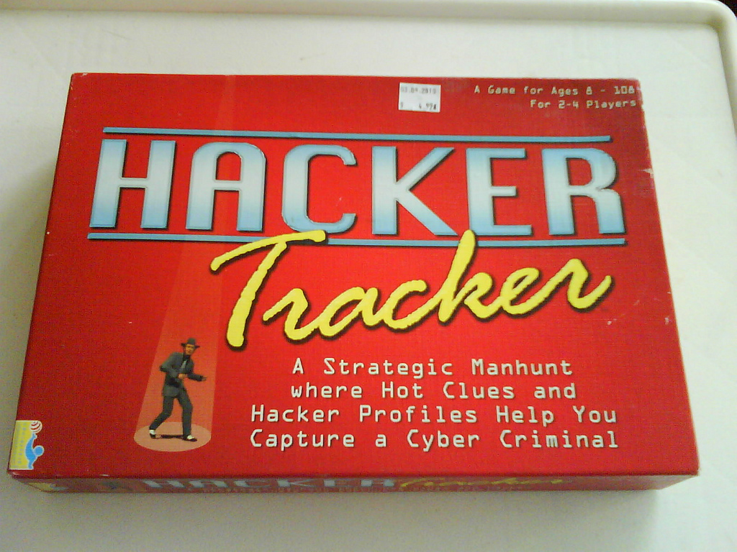
Hacker Games

Slide 8
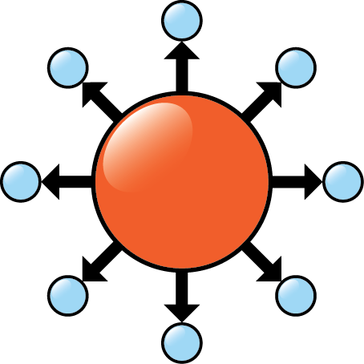
BLUE TEAM

Slide 9
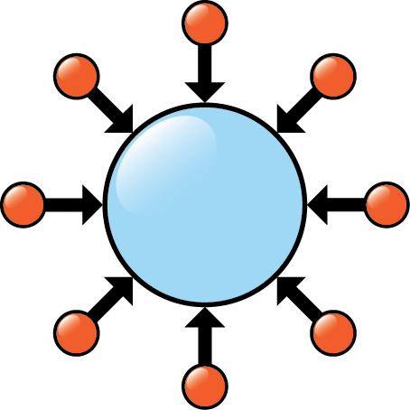
RED TEAM

Slide 10
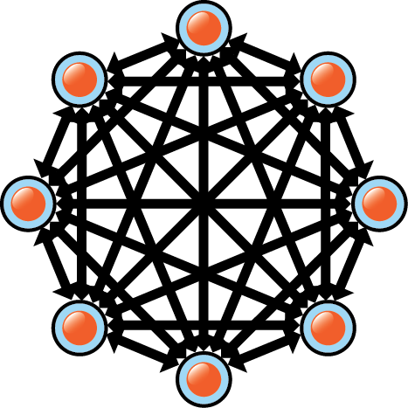
FULL SPECTRUM
Notes:
It should be noticed that there’s an interesting paper from the Defense Science Board outlining some interesting concepts and they use the phrase “full spectrum” to mean adding in guys with guns. Not what I mean here.

Slide 11
CTFs
Collegiate Cyber Defense Competition (CCDC)
Cyber Defense Exercise (CDX)
DEF CON Quals
Ghost in the Shellcode
PlaidCTF
CSAW
Kommand && Kontroll
RuCTF Quals
Nuit du Hack Quals
Hack.lu
DEF CON Finals
CODEGATE YUT
RuCTF Finals
Nuit du Hack Finals
rwthCTF
iCTF
Notes:
And probably hundreds of others. It’s worth pointing out there is massive diversity among the types of CTFs. Web-based CTFs, single challenge based CTFs, shell exploitation with progressive levels, programming CTFs, there are more challenges available than any person could possible solve.

Slide 12
DEF CON CTF History
http://preceden.com/timelines/62839

Slide 13
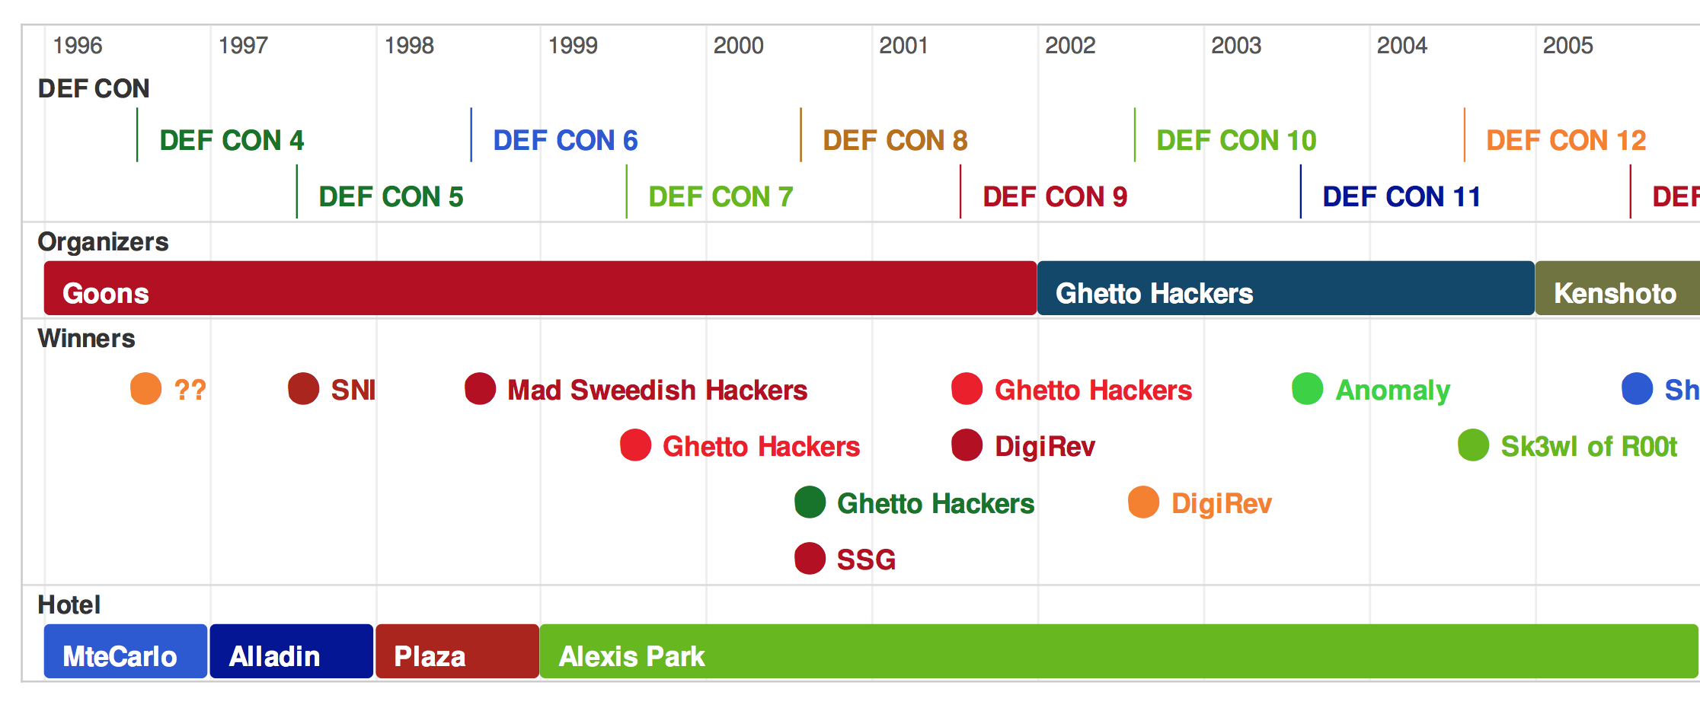

Slide 14
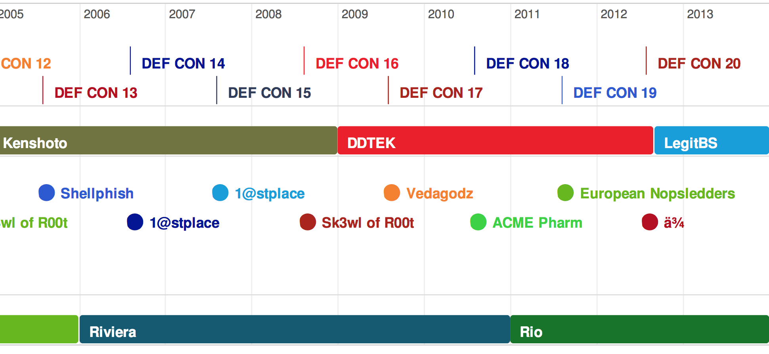

Slide 15
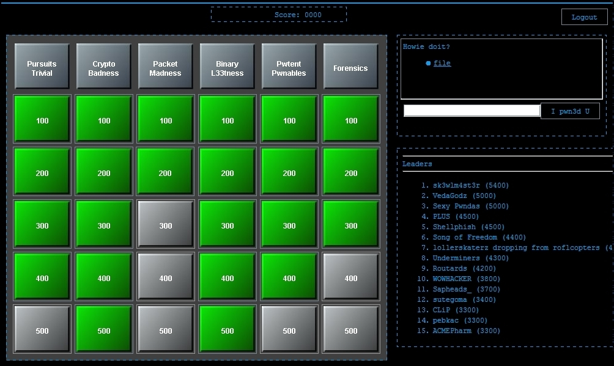
“Jeopardy” (Defcon Quals)
Notes:
I consider this really a subset of the RED team style CTFs. Everyone’s an “attacker”, no one is defending, though arguable, the skills are often more varied.

Slide 16
Why CTF?

Slide 17
Jobs

Slide 18
Skillz

Slide 19
$$
Notes:
For the money! Well, not really. With the exception of PPP who’s made some very good money out of it (but even their numbers – over 100k isn’t nearly as much when you divide it up amongst the many players, the many years, and the costs of participating in many of the competitions). Nobody does it for the money.

Slide 20
Cred

Slide 21
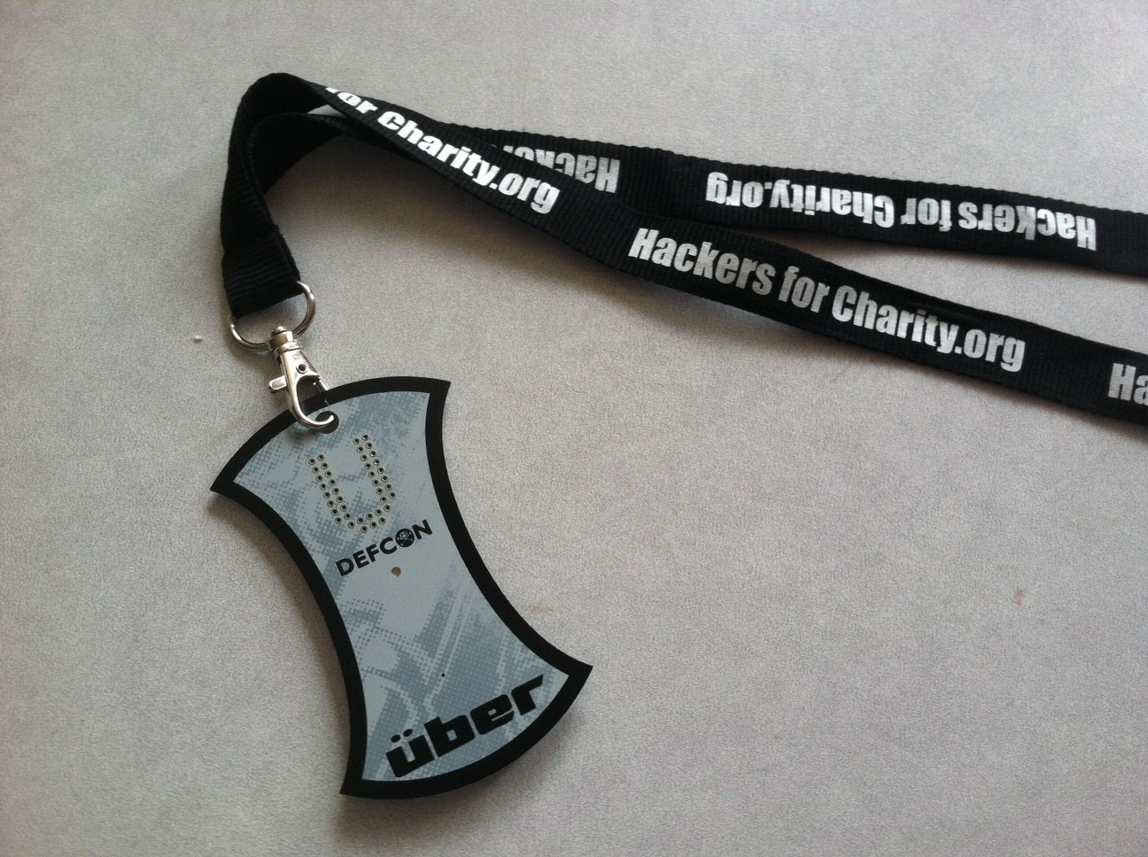
Sold for $3550.01 at auction
Image © http://www.greatestcollectibles.com/wp-content/uploads/2012/09/page-15.jpg

Slide 22
Fun!

Slide 23
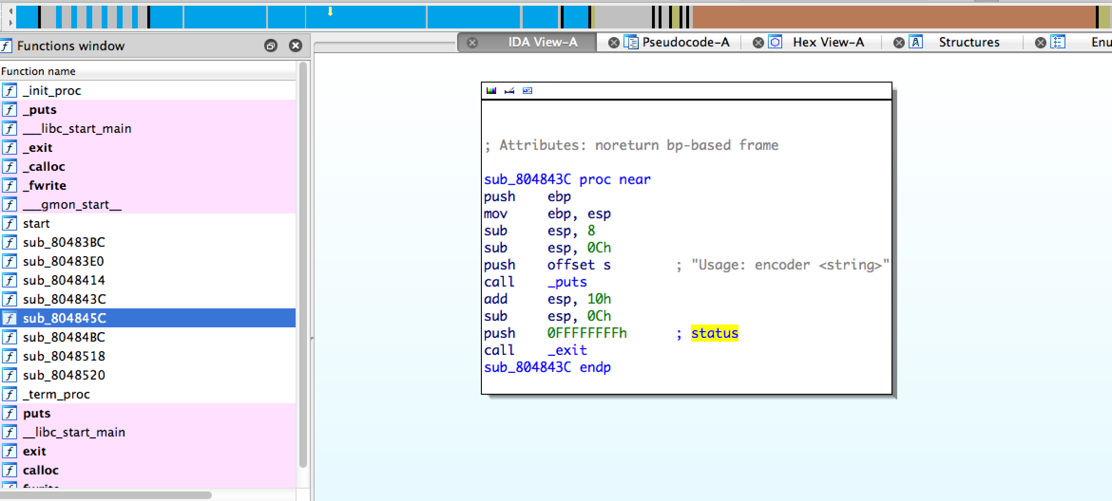
2006 Quals – Reversing 400

Slide 24
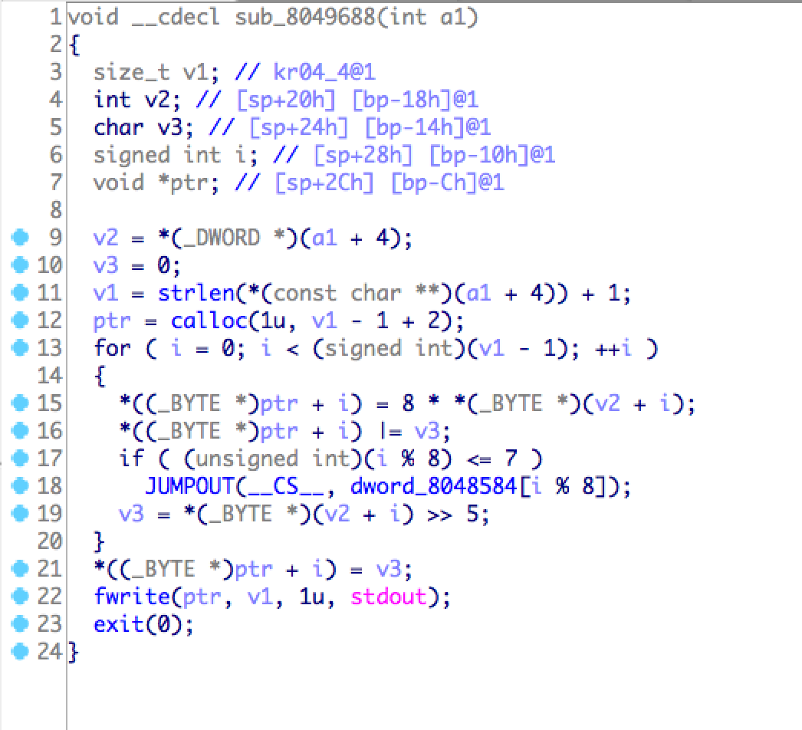
2006 Quals – Reversing 400

Slide 25
2006 Quals – Reversing 400
$ hexdump key.enc
0000000 f9ef 0942 1aa3 f743 8b8c 22bb c22a 14a3
0000010 0003

Slide 26
2006 Quals – Reversing 400
#!/bin/bash
for c1 in {a..z}; do
for c2 in {a..z}; do
echo -e "$c1$c2\t"`./encoder \
"$c1$c2"|hexdump|head -1`
done
done

Slide 27
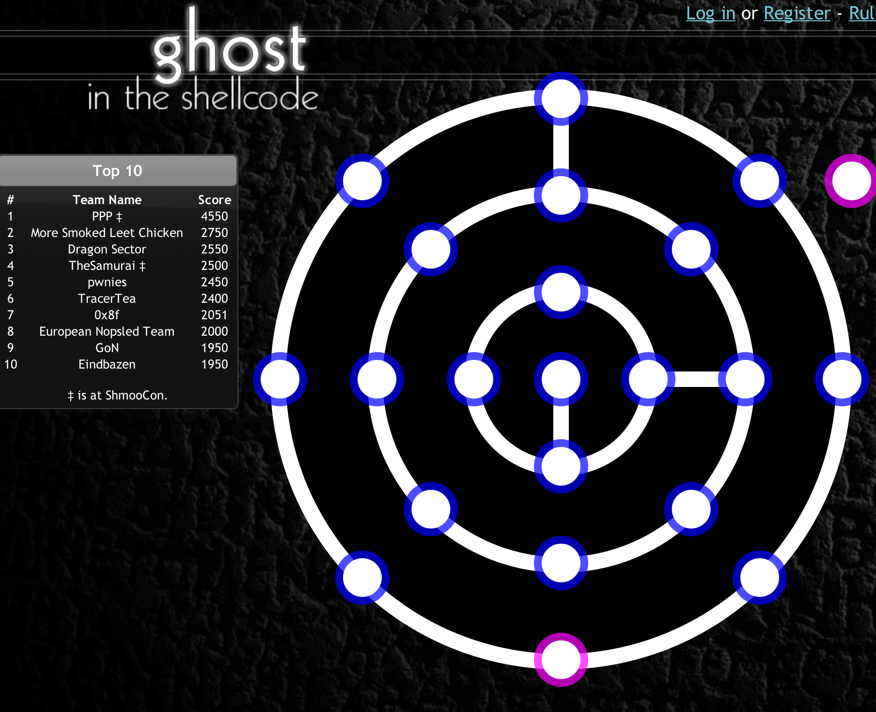

Slide 28
What the hell is keming?
Run “file”
$ file 35e25782a7b3b88409e58756e63c40c2.bin
35e25782a7b3b88409e58756e63c40c2.bin: XZ compressed data
Notes:
Eindbazen writeup: http://eindbazen.net/2013/01/gits-2013-teaser-what-the-hell-is-keming/#more-1626

Slide 29
What the hell is keming?
Run “file”
Read spec (RFC-1952)
“A gzip file consists of a series of ‘members’
(compressed data sets). The format of each member is specified in the following section. The members simply appear one after another in the file, with no additional information before, between, or after them.”
Notes:
Eindbazen writeup: http://eindbazen.net/2013/01/gits-2013-teaser-what-the-hell-is-keming/#more-1626

Slide 30
What the hell is keming?
Run “file”
Read spec (RFC-1952)
Extract / re-arrange
Exercise for the reader. (python, binwalk, shell script)
Notes:
Eindbazen writeup: http://eindbazen.net/2013/01/gits-2013-teaser-what-the-hell-is-keming/#more-1626

Slide 31
What the hell is keming?
Run “file”
Read spec (RFC-1952)
Extract / re-arrange
GOTO 1
$ file output
output: POSIX tar archive (GNU)
$ tar –xvf output
keming/
keming/index.html
keming/pronoun.woff
keming/preposition.woff
keming/adjective.woff
keming/interjection.woff
Notes:
Eindbazen writeup: http://eindbazen.net/2013/01/gits-2013-teaser-what-the-hell-is-keming/#more-1626

Slide 32
What the hell is keming?
Run “file”
Read spec (http://w3.org/TR/WOFF)
Extract / re-arrange
GOTO 1
Exercise for the reader.
Notes:
Eindbazen writeup: http://eindbazen.net/2013/01/gits-2013-teaser-what-the-hell-is-keming/#more-1626

Slide 33
Playing

Slide 34
Skills…
x86/MIPS/ARM/PPC/Atmel
Reverse Engineering
Binary Exploitation
File System Forensics
File Format Forensics
Cryptography
Web App Sec
Hacker Trivia
Emulation/Virtualization
Custom compression
Programming (scripting and the real deal)
PHP “Phun”
Binary Protection Mechanisms
Formal Methods
Network Protocol Analysis
Shellcode Tricks
Number Systems
Bizarre Encodings
Notes:
So with this list to scare you, let’s talk about why it’s not so hard after all. For every skill that someone has in computers, there’s probably been a CTF challenge related to it. You could get anything. That’s part of the fun.

Slide 35
The one true secret to success:
TRYING

Slide 36
Resources
Calendars
  http://captf.com/calendar
  http://ctf.forgottensec.com/wiki
  http://ctftime.org/ctfs/

Slide 37
Resources
Archives
  http://captf.com/
  http://shell-storm.org/repo/CTF/
  http://ctftime.org/event/list/past/

Slide 38
Resources
Practices
  http://captf.com/practice-ctf/
  http://www.wechall.net/
  http://ctf.forgottensec.com/wiki

Slide 39
Resources
Videos
  Hacker Joe (http://youtu.be/6e4kJB4cthA)
  Psifertex(http://youtu.be/okPWY0FeUoU)
  Chris Eagle (http://vimeo.com/29689138)
  Arpaia (http://vimeo.com/30141771)
  ShmooCon (http://youtu.be/c9Rc6DjYJr8)

Slide 40
Running

Slide 41

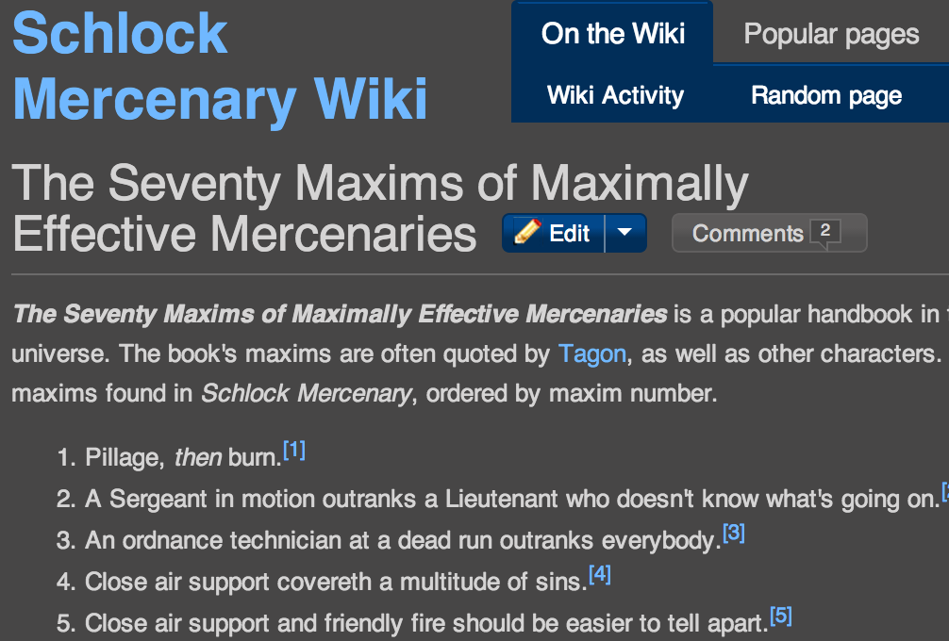
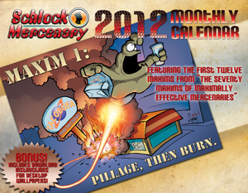
http://schlockmercenary.com/

Slide 42
The Many Maxims of a Maximally Effective CTF
http://captf.com/maxims.html

Slide 43
Maxims
We hack for fun, not for frustration.
The scoring mechanism should always be the easiest challenge.
Solutions might be a surprise, but recognizing when you have one shouldn't be.
When the next step requires a leap of faith, be sure to include a bridge.
An homage honors, but duplication doesn't.

Slide 44
Maxims
Learners always win even when winners don't learn.
Your point estimates are exactly that until calibrated.
Never rely on the survival of a vulnerable server.
Competitors are more clever than you, they also have more time.
Learning starts where prior knowledge ends.

Slide 45
Questions?
THANKS:
family, friends, CTF mates past and present, HackUCF, b-sides organizers!
SLIDES:
http://captf.com/intro

Slide 46
Bonus content!

Slide 47
Other things
Team Organization
Culture of the game
  Good / bad
Strategy
  Sleep
  Play the organizers
  “scrum”

